Slide 1
Social Emotional Learning
*Lessons for 10/08 – 10/12

Slide 2
Overview
Research shows that adolescents who have a purpose that transcends self-interest report higher levels of happiness and success. This lesson prompts students to think about their interests and how they connect to something bigger, so they can make a difference in the world.

Slide 3
Objective
Identify how you can use your interests and strengths to make a difference in the world

Slide 4
Monday Your Interests Matter

Slide 5
Collaborate
What are somethings that are really important to you?

Slide 7
Class Discussion
What are some ways you think the world could be a better place?

Slide 8
Tuesday

Slide 9
Survey
You can make this world a better place by doing something you really like? Explain
Agree Disagree

Slide 11
Class Discussion
What are some things you really like to do that you want to get better at?
What are some resources at your school or in your community that can help you develop these interest?

Slide 12
Activity
Today you are going to answer a series of questions to help identify your strengths and interests you’d like to get better at?
** Pass out Strengths and Interest Inventory to all students

Slide 13
Wednesday

Slide 14
CNN Heroes: is a television special created by CNN to honor individuals who make extraordinary contributions to humanitarian aid and make a difference in their communities. The program was started in 2007.
CNN Hero’s Young Wonders

Slide 15
Video
https://youtu.be/yh1Kd98B6nQ

Slide 16
Video
https://youtu.be/j5_MFYzTcKA

Slide 17
Thursday

Slide 18
Collaborate
What are some things you really like to do that you want to get better at?

Slide 19
Activity
In this activity, you'll explore the connections between your interests and your ideas of a better world.
You're going to see 5 versions of a better world.
As a class, vote for the world you most want to live in.

Slide 20
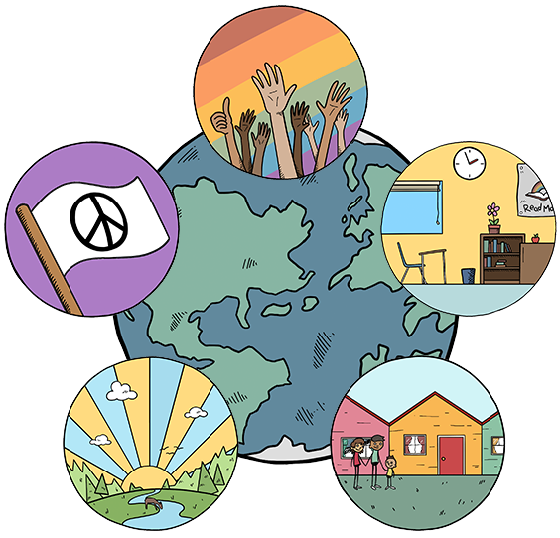
As a class, vote for the world you most want to live in.
Tolerance
No War
Safe Schools
Clean Air
No Homelessness

Slide 21
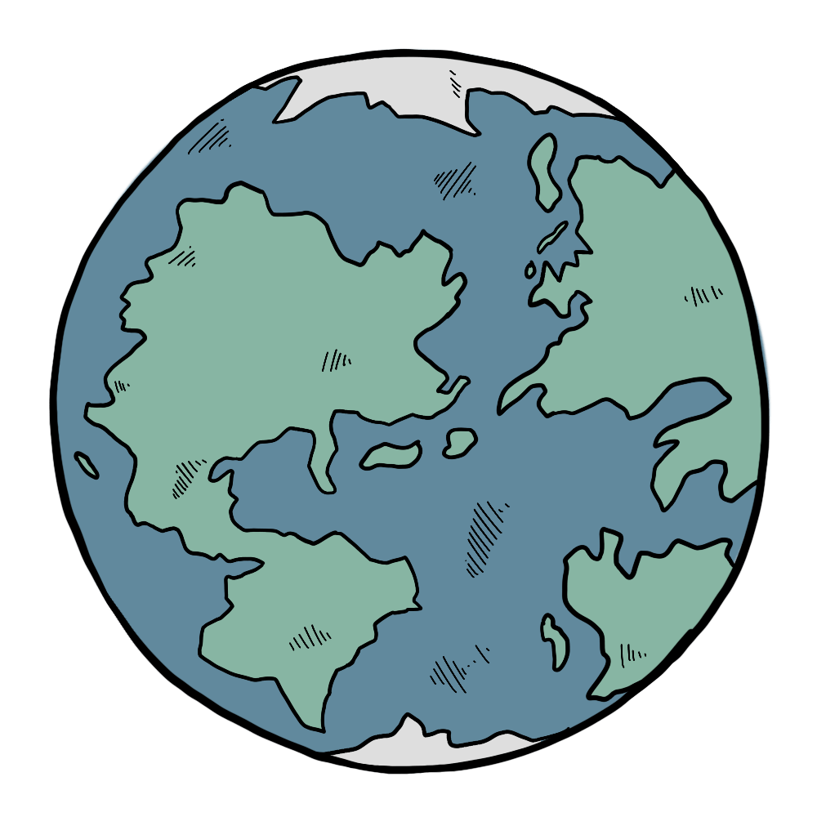
How can you use your interests to help create this world?
Choose the interest you'd most like to get better at
With a partner, think of a way you could use your interest to make the world better
Be ready to share your ideas with class tomorrow
Example 1
Example 2

Slide 24
Friday

Slide 25
Class Share
Share your plans from yesterday.
Describe another way you think the world could be better and how you could use your interest to help create that world

Slide 26
CNN Hero’s Young Wonders
https://www.youtube.com/watch?v=uLKRx5TNYtk

Slide 27
CNN Hero’s Young Wonders
https://www.youtube.com/watch?v=FFwmM2DZ-Ak

Slide 28
Optional Video & Activities

