Slide 1
Social Emotional Learning
*Lessons for 9/10 - 9/14

Slide 2
Overview
Values are a resource students can turn to and use in a wide range of situations. Identifying, focusing on, and remembering values has been shown to improve coping skills and positive decision making. Research on values shows that focusing on them increases people’s resilience to stress and improves psychological well-being.

Slide 3
Objective
Identify core personal values
Analyze the connection between values and decisions

Slide 4
Monday 9/10 What are Values?

Slide 5
Collaborate
1. Who is someone you admire?
2. What do you admire about this person?

Slide 7
Class Discussion
Values are the things that matter to you most.
They have to do with the kind of person you are or want to be.
Everyone has values.
What are some of yours?

Slide 9
Tuesday 9/11 Do values affect my decisions?

Slide 10
Collaborate
Your values influence the decisions you make, even if you aren't thinking about them.
1. Think of something you decided to do today (for example, you got up, went to school, and went to class).
2. How did your values influence that decision?

Slide 12
Video: What would YOU do?
“What would YOU do” T.V show, gives us an opportunity to ask ourselves what would we do when put in a situation?
It gives us the opportunity to ponder our values and how it can influence our decision when no one is looking.
As you watch the video clip think about what YOU would do and what values influence you decision

Slide 13
Video – Employee Steals from the Store
https://www.youtube.com/watch?v=I4uDU8XYzlI

Slide 14
Video – Boys selling fake tickets
https://www.youtube.com/watch?v=OhdcZC3BLAI

Slide 15
Class Discussion
1. What are some values that influenced the customers decision?
2. What would you have done in the situation?

Slide 16
Wednesday 9/12 Using values to make decision.

Slide 17
Collaboration
You can also choose to think about your values before making a decision.
This can be particularly helpful in difficult situations.
How can thinking about your values help you make good decisions?

Slide 18
Activity
1. As a class, choose a scenario below
2. Individually, use your values to decide what you would do

Slide 19
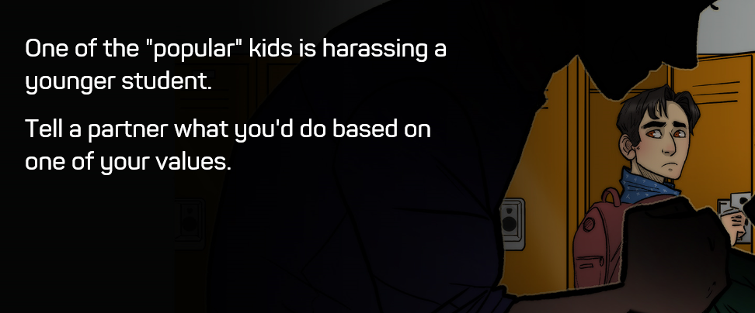

Slide 21
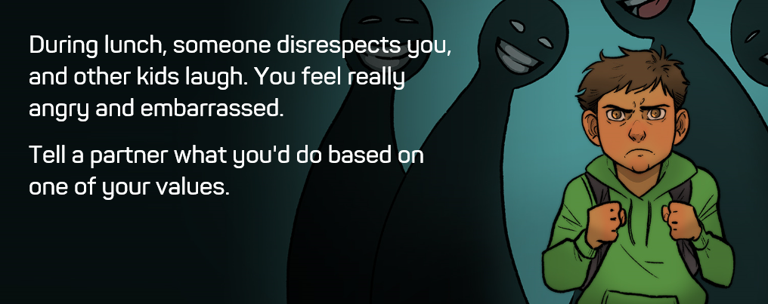

Slide 22
Class Discussion
Is it always easy to remember your values when you have to make a quick decision in a difficult situation?
Why or why not?
What can help you remember your values?

Slide 23
Thursday 09/13 The Art of Values

Slide 24
Activity
Each of you will choose a value that’s important to you and create a picture, collage, poem, song or video that represents that value.
Don’t tell anyone else the value you’ve chosen.

Slide 25
Steps
Choose a value you find important (shhh.. don’t tell anybody)
Draw a picture, create a collage, write a song, poem, video clip, cartoon or any creative project that represents your value
All completed projects will receive ONE POINT for there house.
4. All projects must be turned into teacher by Monday morning or submitted to

Slide 26
Activity Resources
Video: www.animoto.com or Animoto App

Slide 27
Friday 09/14 The Art of Value

Slide 28
The Art of Values
Have students who have completed their value project show his or her project while the rest of the class tries to guess which value it represents.
Give students time to complete project
All projects must be completed and submitted to teacher by Monday 9/17 to receive a point for there house.

Slide 29
Kahoot – Guess the Value
https://play.kahoot.it/#/k/73b05865-57b1-4df0-8315-334c31592f25

Slide 30
Optional Video & Activities

Slide 31
Video –
https://www.youtube.com/results?search_query=CBS+Denver++Kids+Return+Found+Wallet+To+Owner

