Slide 1
Social Emotional Learning
*Lessons for 9/04-9/07

Slide 2
Overview
A healthy self-concept is key to students’ success and well-being in school and in life. During adolescence, students are developing their sense of self. This lesson guides them toward evaluating themselves in favorable ways, based on how they see themselves now and in the future and the positive traits others see in them.

Slide 3
Objective
Recognize that identity is complex and shaped by many factors
Learn what aspects, both internal and external, make up your identity
Recognize that people change and discuss the effects of this change

Slide 4
Tuesday 9/4 Self Awareness

Slide 5
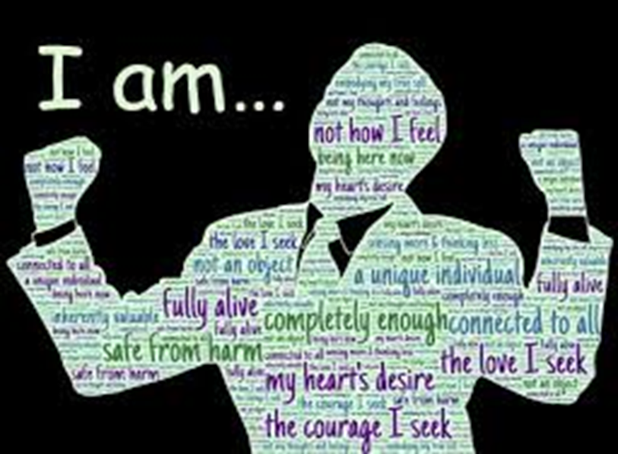
What is Self-Awareness?
The ability to accurately recognize one’s own:
Emotions
Thoughts
Values
All of these things influences your Behavior

Slide 6
Collaborate
What are some adjectives a person might use to describe someone?
Note: adjectives should be words that describe how a person acts or treats others.

Slide 7
Self-Awareness in action
https://www.youtube.com/watch?v=HIhEMk7CZ-A

Slide 8
Class Discussion
What somethings that shape our self –conscious?
How do we get in the way of being aware and being who we are?

Slide 9
Wednesday 9/5 Video- What would you do?

Slide 10
Collaboration
Identity is your answer to the question "Who am I?“
1. What is your identity?

Slide 11
Collaboration
Your answer to the question "Who am I?" will evolve over your lifetime.
2. What parts of your identity do you think will change?
3. What will stay the same?

Slide 12
Collaboration
Adolescence is when most people really start thinking about their identity for the first time.
Teens often "try on" different identities to see which ones “fit”.
1. What are some identities teens try on?

Slide 13
Video

Slide 14
Class Discussion
People in the video described different aspects of their identities.
What are some aspects of your identity?
Think of the different ways you would finish the sentence
“I am ____________________”’

Slide 15
Thursday 9/6 “I am” …..

Slide 16
Collaborate
Think of words you could use to describe yourself.
Share some

Slide 17
Activity
Write your name in the center of a sheet of paper
Take a few minutes to reflect on the question "Who am I?“
Around your name, draw an identity map

Slide 18
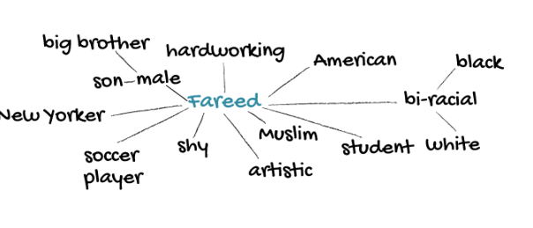
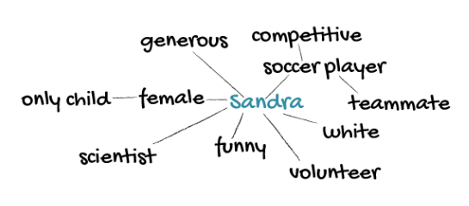
Example Identity Map
An identity map is a visual representation of your identity. Write your name in the center of your paper and then add aspects of your identity around it.

Slide 19
Friday I am Me!

Slide 20
Warm- Up
Get our your “I Am” webs from yesterday
Circle the aspects of your identity that are most important to you.

Slide 21
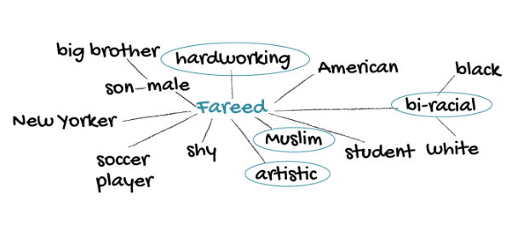
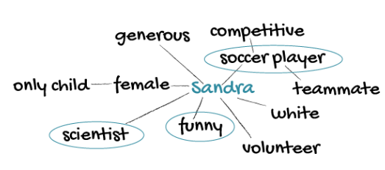
Activity

Slide 22
Video – This is Me
https://www.youtube.com/watch?v=XLFEvHWD_NE

Slide 23
This is Me - Activity
Choose one of the most important aspects that you circled on your identity map.
Write a paragraph describing why it's important
-or-
Draw a picture of yourself that shows this aspect of your identity
-or-
Create a www.wordart.com/create

Slide 25
Optional Video

Slide 26
Video – What would you do?
https://www.youtube.com/watch?v=iYzZnQNwEls

