Slide 1
Social Emotional Learning
*Lessons for 9/24 - 9/28

Slide 2
Overview
Thinking about the kind of friend they want to be helps students create positive relationships with peers. Identifying friendship values is a focused way for students to clarify what's important to them in friendships and think about specific ways to make good peer connections.

Slide 3
Objective
Explore the values that are important for friends to have
Analyze how your values affect your relationships with friends

Slide 4
Monday 9/24

Slide 5
Collaborate
How would you feel if you were isolated, lonely, or treated as if you were invisible?
Where does social isolation happen at our school?

Slide 6
In every school and community, many are
ALONE, ISOLATED & QUIETLY
SUFFERING through each day

Slide 7
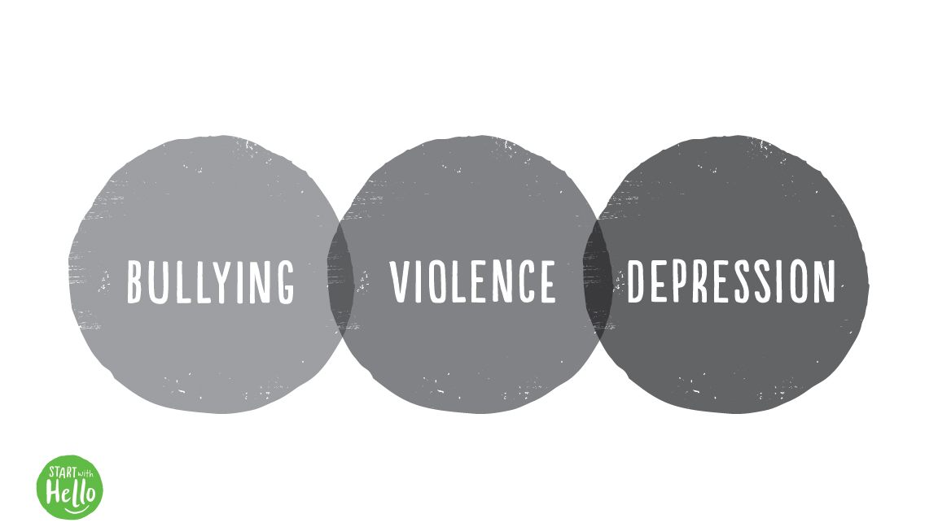
As a result, young people who are lonely
or isolated can become victims of…
Notes:
As a result, young people who are isolated can become victims of bullying, violence and/or depression and sadness.

Slide 8
Pulling away
from society
Struggles with social
development & learning
Development of physical health issues
Hurting themselves
or others
Notes:
This leads many to further pulling away from society, struggling with learning and social development, developing physical health issues and/or, in extreme instances, self-harm or harming of others because they can no longer cope.

Slide 9
ONLY YOU CAN CREATE CONNECTEDNESS
Notes:
Starting today, we are creating a connected community, a community where we can easily and simply reach out to one another and be inclusive and belonging. We are creating a community that supports and looks out for one another. To do this, we need you. It is the only way to achieve this … only you can create the connectedness. And the good news is, that this is simple to do …. just Start With Hello.

Slide 10
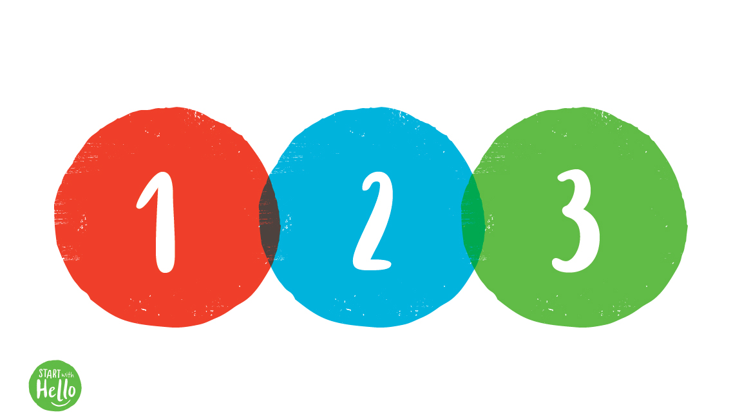
In just 3 simple steps…
Notes:
3 steps to help create a inclusive and connected classroom, school and/or community. The steps are easy, simply, when you …

Slide 11
Notes:
Step 1: SEE someone ALONE.

Slide 12
Notes:
Step 2: REACH OUT and HELP.

Slide 13
Notes:
3. Just START WITH HELLO.

Slide 14
Sit with someone who may feel alone
Reach out on social media
Invite someone to join you
Give a simple gesture to someone
Leave a handwritten note
GO DO IT TODAY!!!
14

Slide 15
Tuesday 9/25 What kind of friend are you?

Slide 16
Collaborate
Tell the class about something nice you did recently for a friend of yours.
What something nice you’ve seen someone else do this week?

Slide 17
VIDEO

Slide 18
Class Discussion
What values do you think are important for a friend to have?

Slide 19
Wednesday 9/26 Positive Sticky Note

Slide 20
Collaborate
Describe something you've done recently that shows one of those values you think are important in a friend.

Slide 21
https://www.youtube.com/watch?v=08cnWLV33y8

Slide 22
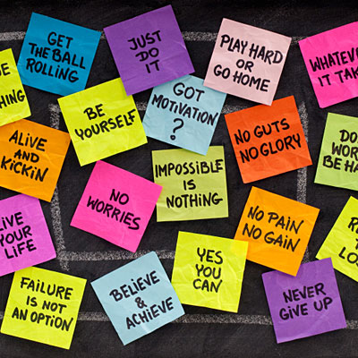
Activity: Positive Sticky Note Challenge
I challenge you to make one sticky note and leave it somewhere for somebody to find this week!

Slide 23
Thursday 9/27 Positive Relationships

Slide 24
Collaboration
1. What are somethings that can make it hard to be a good friend?
2. What are somethings you could do based on your values to overcome the issue you identified?

Slide 25
VIDEO
https://www.youtube.com/watch?v=cBtFTF2ii7U

Slide 26
Class Discussion
What are some values Bella and Tara show in their friendship?
What are some differences they had to get over to be friends?

Slide 27
Friday 9/28 Positive Relationships

Slide 28
Survey
To have good friends, you must be a good friend.
Thumbs up if you agree.
Thumbs down if you disagree.
Explain your thinking.

Slide 29
Survey
People can get into conflicts and still be friends.
Thumbs up if you agree.
Thumbs down if you disagree.
Explain your thinking..

Slide 30
Collaboration
1. What are some possible signs of a positive
relationship?
2. How can remembering your values help you be
a good friend?

Slide 31
VIDEO

Slide 32
Class Discussion
1. Choose one of your values.
2. Describe a time
when remembering it helped you be a good
friend.

Slide 33
Optional Video & Activities

