Slide 1
Social Emotional Learning
*Lessons for 9/18- 9/21

Slide 2
Overview
Student conflicts often start or escalate online. Thinking about values can help students clarify how they want to behave. This lesson helps students apply their values to online social interactions.

Slide 3
Objective
Identify values that contribute to a positive online world
Create a values-based plan for how to help build a positive online world

Slide 4
Tuesday 9/18

Slide 5
Collaborate
What values do you see people show here at school?
How do they show them?

Slide 6
Video

Slide 7
Class Discussion
How do other students' values affect how you feel about being at school?

Slide 8
Wednesday 9/19 Values & Social Media

Slide 9
Collaborate
Is your most important value at home different from your most important value at school?
Do people have the same values on social media as they do in person?

Slide 10
Video

Slide 11
Class Discussion
What can make it difficult for people to remember their values when they're texting or socializing online?
How can what you do online to make your online (social media) world a better or worse place?

Slide 12
Thursday 9/20 What would you do? Cyberbullying

Slide 13
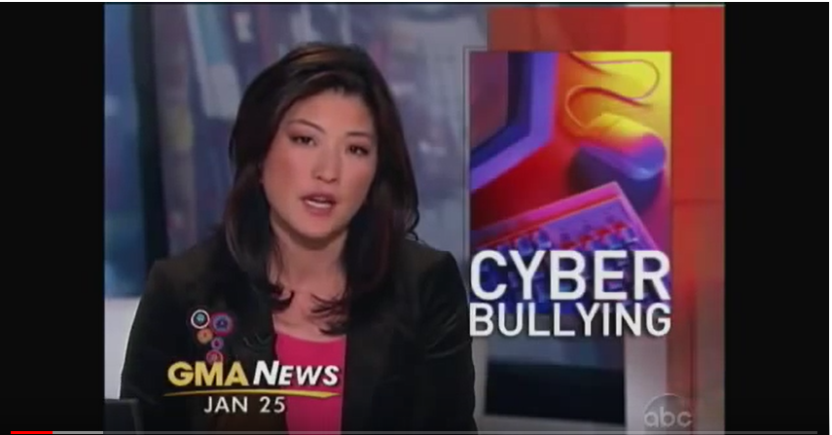
https://www.youtube.com/watch?v=PC0l2RFNh-U&t=29s

Slide 14
Class Discussion
What would you have done?
Is it OK to just ignore cyberbullying as long as you do not participate?

Slide 15
Friday 9/21

Slide 16
Collaborate
Have you ever witnessed people being mean online?
Have you ever joined in?

Slide 17
Class Discussion
Tell us about a time you witnessed someone getting picked on online. What happened and what caused it to stop?
Online bullying is when someone keeps being mean to someone else on purpose online. How can the effects of bullying be amplified when they happen online?
Who can you go to for help if you witness online bullying? Why would you go to that person?

Slide 18
Optional Video & Activities

Slide 19
Video –

