Slide 1
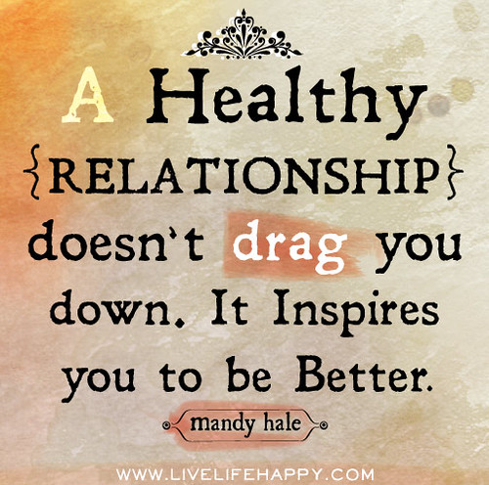
Positive Peer Relationships
5/12 - 5/17

Slide 2
Overview
This weeks lesson will focus on: Different elements that help form healthy relationships. We will also learn about behaviors that we should avoid if we wish to have healthy relationships with others, as well as recognizing these behaviors in others to help recognize unhealthy relationships. Then we will work together to practice using the positive behaviors and avoiding the negative ones when interacting with peers. Maintaining positive healthy peer relationships. While everyone has to decide for themselves what a healthy relationship is, and what defines a positive relationship here are some qualities to consider.

Slide 3
Qualities of a Good Friend
Treat each other with respect,
Can resolve conflicts satisfactorily
Enjoy the time you spend together
Support one another
Take interest in each other’s lives: school, clubs, friends family, etc.
Can trust each other
Communicate clearly and openly
Encourage other friendships
Have more good times in the relationship than bad

Slide 4
Objective
By the end of this lesson, students will be able to:
Describe at least 3 healthy and 3 unhealthy characteristics of
relationships.
Compare at least 2 positive and 2 negative ways friends and peers
can influence relationships.
Learn to recognize these unhealthy behaviors in others

Slide 5
Monday
What is Friendship

Slide 6

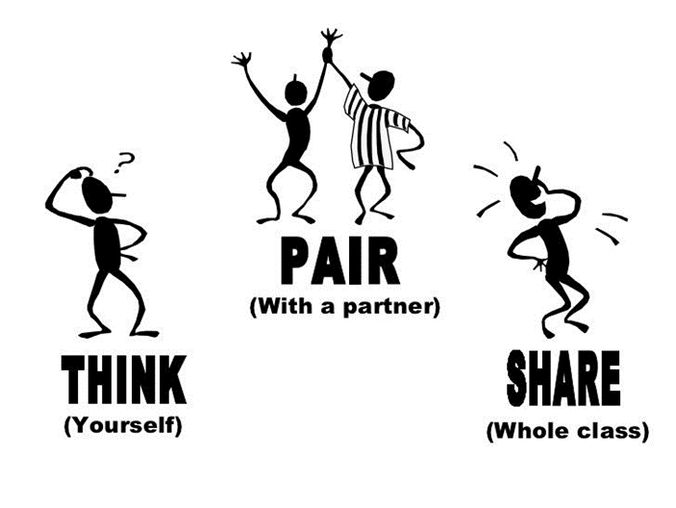
Making Connection
What is a good friendship made of, or what does it mean to be a good friend?
Why are friendships a good thing?

Slide 7
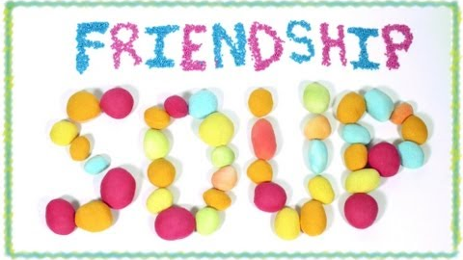
Video
https://youtu.be/H7w7yXkJTu0

Slide 8
Tuesday

Slide 9
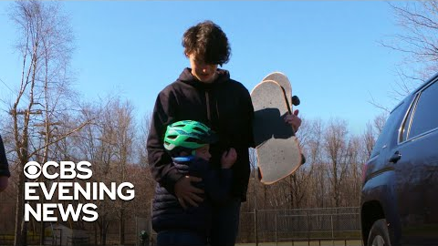
https://www.youtube.com/watch?v=RmQczPAz5Os

Slide 10
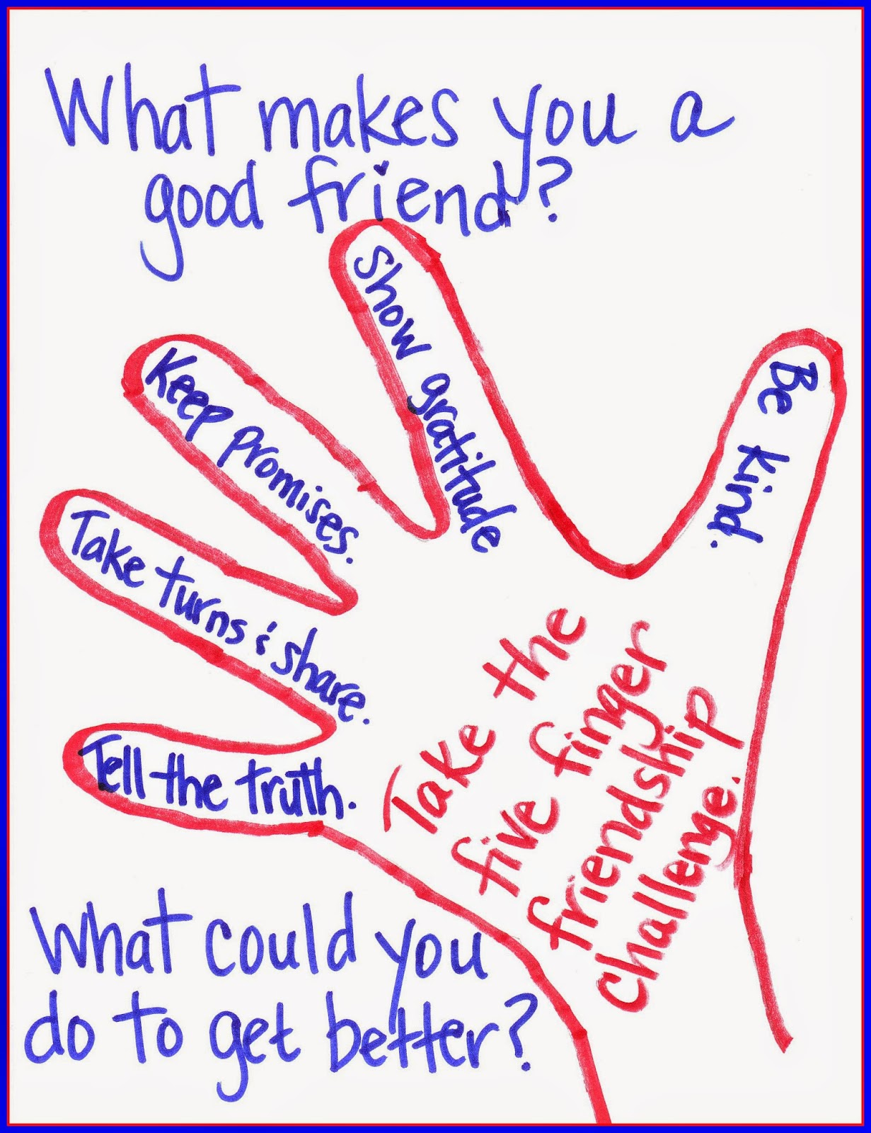
Class Discussion
What are some positive characteristics to look for it friends.
What are some negative characteristics to look for in friends

Slide 11
Thursday
Recognizing unhealthy relationships

Slide 12
Making Connections
What are some characteristics of a healthy friendship?
What are some characteristics of an unhealthy friendship?

Slide 13
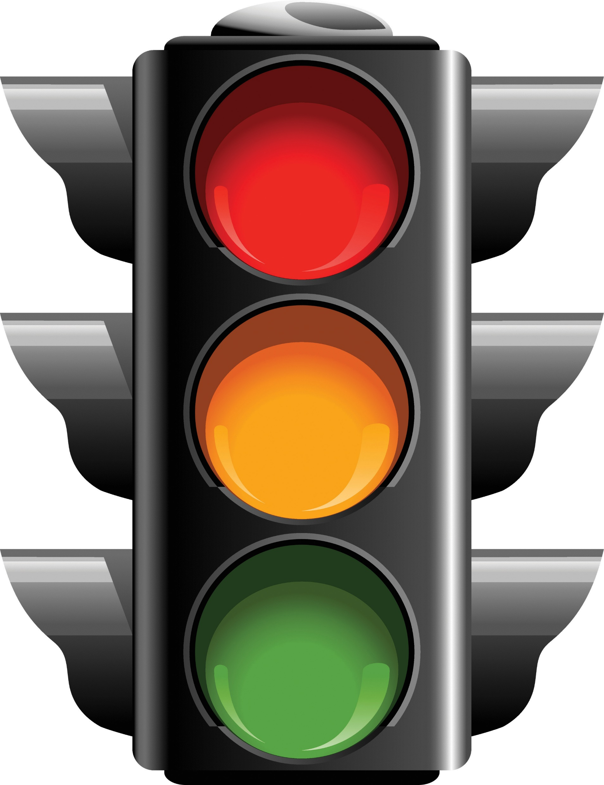
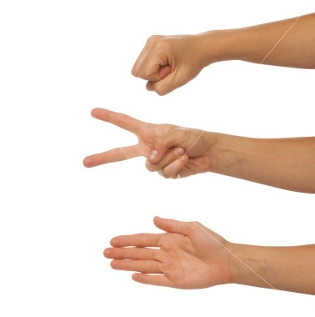
Friendship Stoplight Game
Recognize examples of positive and negative behaviors related to healthy and unhealthy relationships.
Purpose: the purpose of this activity is to explore friendships using a stoplight analogy
Directions: Read through each Friendship scenario and decide if this a red, yellow or green scenario. Use the hand signs to share your decision.
RED = Stop! These are bad signs of a friendship!
b. YELLOW = Caution! These are warning signing of a friendship!
c. GREEN = Go! These are good signs in a friendship!

Slide 14

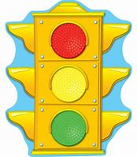
Your friend criticizes you or people you care about

Slide 15
Your friend makes fun of you sometimes

Slide 16
You are nervous that if you tell your friend something personal they will tell other people at school

Slide 17
Your friend is always happy when good things happen to you

Slide 18
Your friend makes fun of other students at school

Slide 19
You enjoy spending time with this person, but you also enjoy spending time with other friends

Slide 20
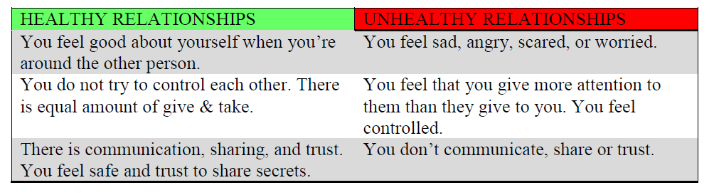

Slide 21
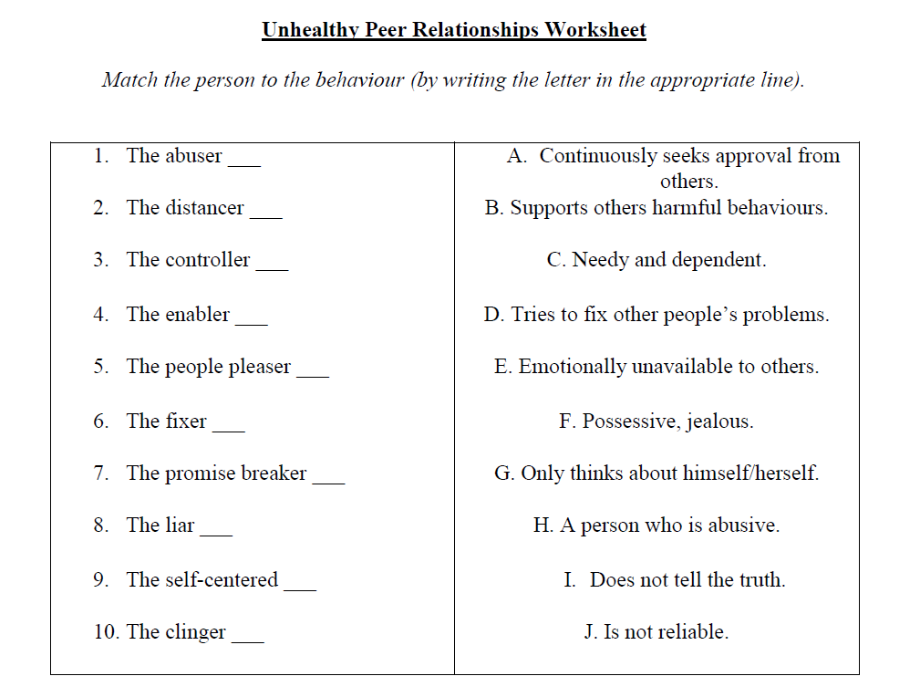

Slide 22
Friday
Good sportsmanship

Slide 23
Making Connections
What does it means to be a good sport?
Why is it important to be a good sport in a peer relationship?

Slide 24
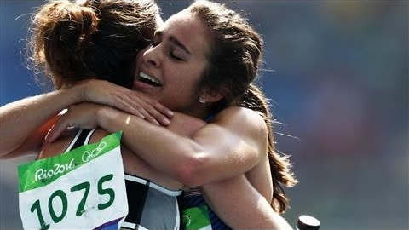
https://youtu.be/t3pf6OHCVR0

Slide 25
Optional Video & Activities

