Slide 1
Social Emotional Learning
*Lessons for 11/5 – 11/9

Slide 2
Overview
Studies suggest that more than 80% of our students feel stressed out at school, most all of it is bad stress. The amount of stress matters, and can impact student academic performance as well. While low levels of stress (good stress) can boost memory formation, improve motivations and keep students focused; high levels of stress (bad stress) can impair a student’s ability to retrieve memories, making it more challenging to pass tests, write papers, or make a presentation in class.

Slide 3
Objective
Identify what causes stress and what the emotional and physical effects are
Identify the difference between good & bad stress
Explore a variety of techniques to manage stress

Slide 4
Monday What causes stress

Slide 5
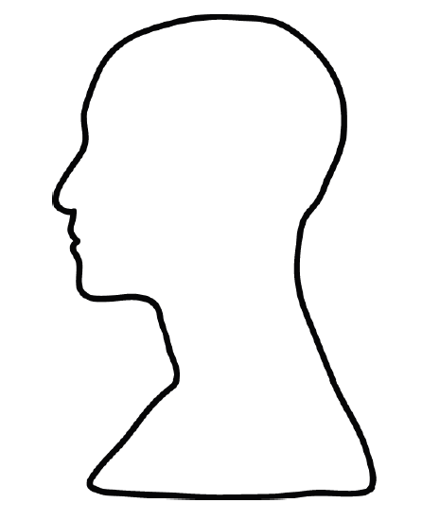
Stress
What causes stress
Individually or with a partner sketch the head outline on a piece of paper and brainstorm for 4 minutes.
Around the outside of the head, write what often causes you stress.
Inside the head, write how it makes you feel emotionally.
In the body area, write what some of the physical effects are on your body.
How stress makes you feel emotionally
Physical effects of stress

Slide 6
What causes stress?
illness
arguments
Work that feels too hard
Too much work
Worrying about the future
Worrying about the past
tests
Feeling overwhelmed
Not knowing what to do
Difficult people

Slide 7
What are the emotional effects of stress?
Forgetfulness
Loss of sense of humor
Difficulty making decisions
moodiness
Short temper
Lack of concentration
Constant worry
negativity
Loneliness
unhappiness

Slide 8
What are the physical signs of stress?
Headaches
Lack of concentration
irritability
Change in eating habits
Heart racing
Change in sleeping habits
Shaking
Rapid
breathing
Feeling sick
Stomach knots

Slide 9
Video: What is Stress
https://www.youtube.com/watch?v=hnpQrMqDoqE

Slide 10
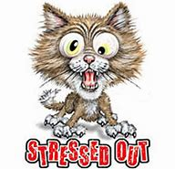
Class Discussion
What are somethings you do when you are stressed out?

Slide 11
Tuesday Good Stress vs Bad Stress

Slide 12
What is Stress?
It’s a feeling that is created when we react to certain events.
It’s your body’s reaction to a situation that challenges you.
There are both good and bad types of stress

Slide 13
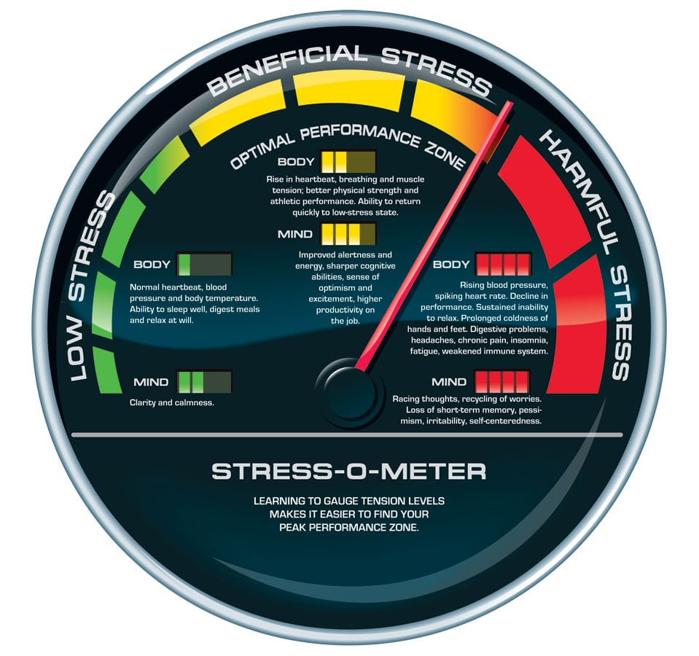
Collaboration
What are some examples of good stress?
What are some examples of bad stress?
Wi

Slide 14
Good Stress short term stress | Bad Stress long term stress
Good stress can keep you focused and motivated to get things done. Examples: Studying for a test Practicing for a music solo Getting ready for a track meet First dance recital | Bad stress is what you feel when you can’t stop worrying about something and you feel overwhelmed all the time.

Slide 15
Why do we get Stressed
Physical stress symptoms date back to our caveman ancestors who relied on stress to help their bodies react quickly to either fight or run from danger: known as fight or flight.
Stress activates our nervous system to release hormones such as adrenalin and cortisol, into our bloodstream.
These hormones speed up our heart rate, breathing rate, blood pressure, energy and sweat production (to cool the body) so it is quickly prepared to fight or run.

Slide 16
How to handle stress
Get active: Stress hormones are getting your body “ready for action” (even if there is no physical danger), so doing exercise helps use them up and de-stress you. Choose an exercise that you enjoy.
Get enough sleep: As a teenager, your body is growing at a very fast rate and so sleep is important for your development. Not sleeping enough can leave you feeling emotional and you may find it difficult to concentrate, all making the effects of stress much worse.
Manage your time: Too much of anything can be bad for you, so work out a plan to manage your time so that you can get your work done and have time to yourself.

Slide 17
How to handle stress
Have fun: It is important to take a break from your problems every now and then, and allow yourself time to do things you enjoy doing. This gives your body and mind a chance to relax and de-stress.
Keep healthy: Choose vitamin rich foods to keep your body and mind balanced, and avoid caffeine which can increase feelings of anxiety and agitation.
Talk about it: It has been said that “a problem shared is a problem halved”. It can really help to just talk to someone you trust. Chances are, someone has experienced something similar and can offer advice or a friendly ear.

Slide 18
Wednesday Relaxation Exercises

Slide 19
Collaboration
With the person next to you, spend 2 minutes discussing what you do to try and keep your stress under control.
Share with the class.

Slide 21
Video: Release
https://www.youtube.com/watch?v=GVWRvVH5gBQ

Slide 24
Thursday Stress Busters

Slide 25
Stress Busters
Pass out the Stress Busters list to all students
Have students pick one suggestions and give an example of how it could be used.
Example:
Quick Fix - I play with kinetic sand
Imagery – I watch Oddly Satisfying Calm Videos on Youtube
Stress Buster List: http://selmatters.weebly.com/uploads/1/2/0/5/120562389/stress_busters.pdf

Slide 26
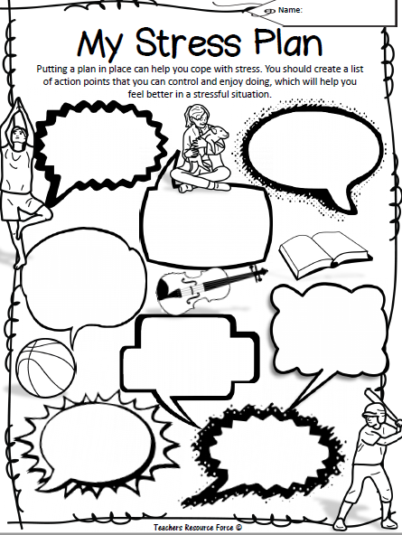
My Stress Plan
Putting a plan in place can help you cope with stress.
Create a list of action points that you can control and enjoy doing, which will help you feel better in a stressful situation.
http://selmatters.weebly.com/uploads/1/2/0/5/120562389/my_stress_plan.pdf

Slide 27
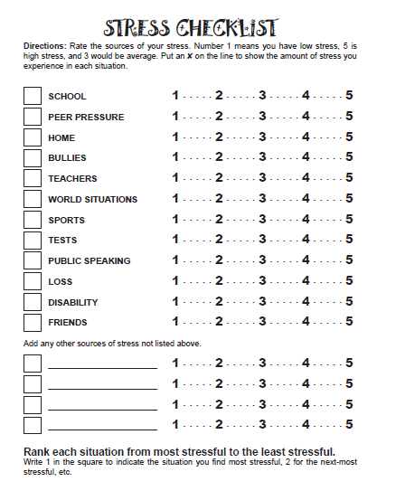
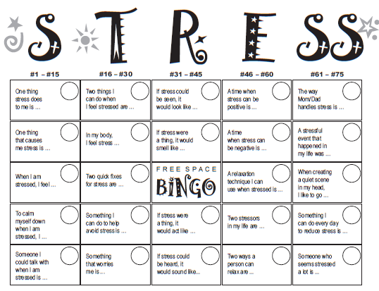
Optional Activities
Stress Checklist
Stress Bingo

Slide 28
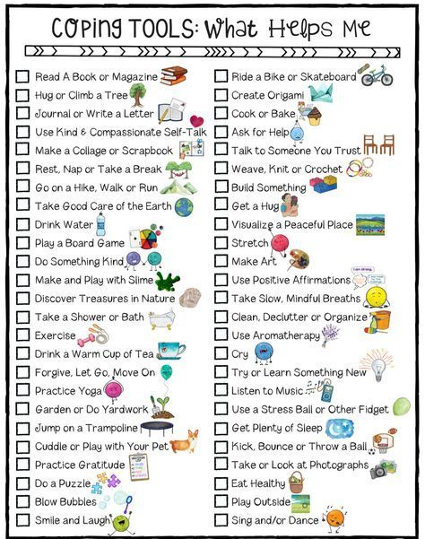
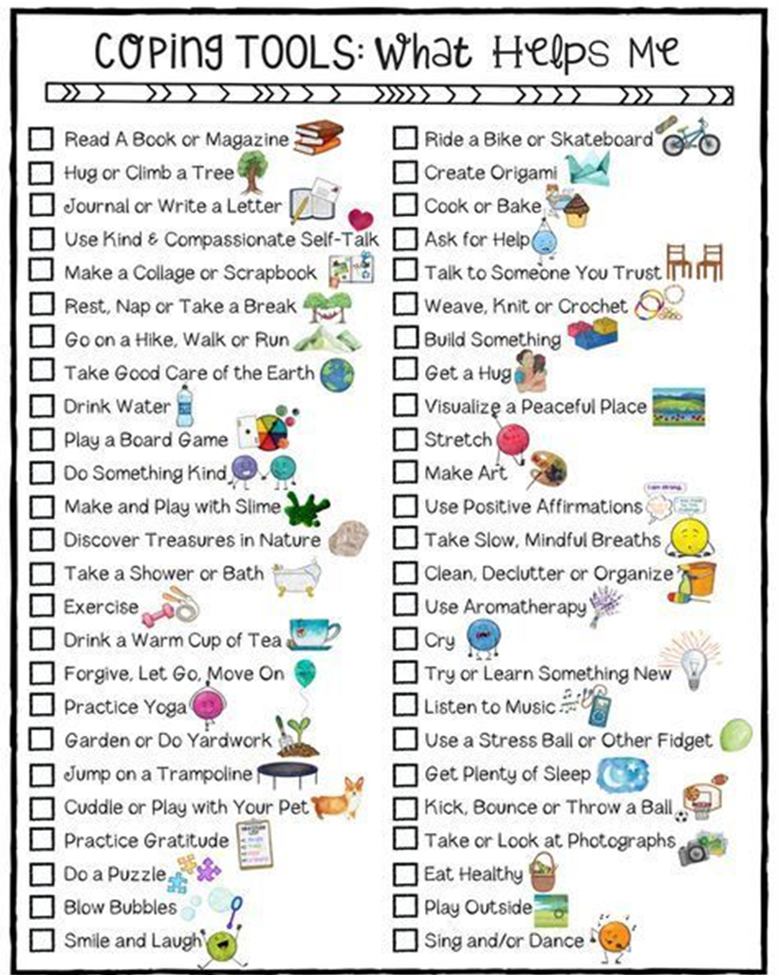

Slide 29
Friday

Slide 30
Video – What if Stress could be your friend
https://www.youtube.com/watch?v=RcGyVTAoXEU

Slide 31
REMEMBER
You must accept that there are some things you cannot change
But you can change how you think about things.

Slide 32
Optional Video & Activities

