Slide 1
Social Emotional Learning
*Lessons for 10/01 - 10/05

Slide 2
Overview
Strong social skills are linked to a wide range of positive outcomes for students. Thinking about what makes a strong friendship and coming up with positive strategies to develop these friendships can help students deepen and strengthen positive peer relationships.
Friendships, relationships, and social groups can change rapidly during middle school. This lesson helps students weather those changes and better understand how to cope with changing friendships and social relationships

Slide 3
Objective
Identify strategies to strengthen friendships
Identify ways to cope when friendships change or end

Slide 4
Monday Strengthening Friendships

Slide 5
Collaborate
1. Why are good, strong friendships important? What difference do they make in people's lives?
2. Tell the class about something positive a friend has done for you recently.

Slide 6
Video

Slide 7
Survey
Survey
says ….
Which strategies from the video have you used to strengthen your friendships?
Help friend with problem | Trust your friend
Listen | Be honest
Put effort into your friendship | Check in with your friends

Slide 8
Tuesday

Slide 9
Collaborate
What are some issues that can come up between friends?

Slide 10
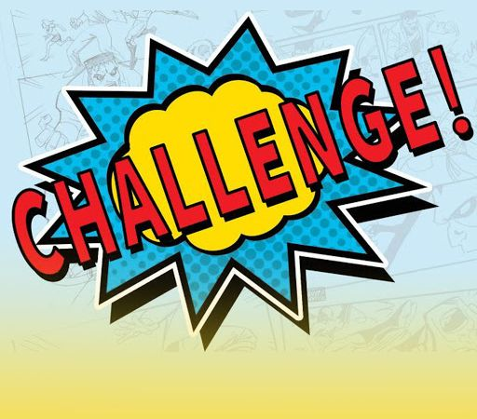
Activity
In this activity, you are going to solve problems between friends to keep their friendships strong.

Slide 11
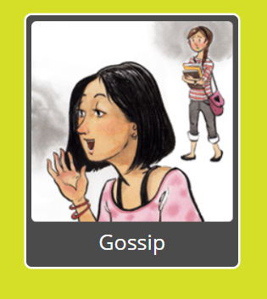
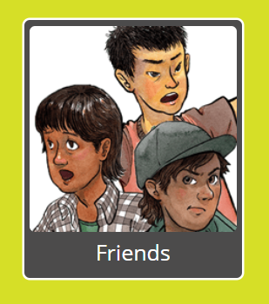
Choose a scenario.

Slide 12
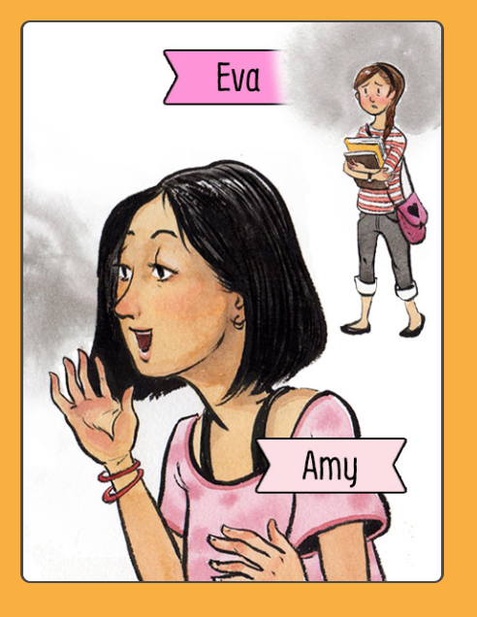
Scenario
Amy and Eva are friends. Eva caught Amy gossiping about her, and now she won't talk to Amy.
Click below to see what they're thinking.

Slide 13
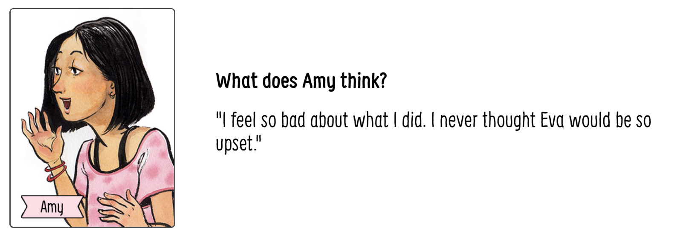

Slide 14
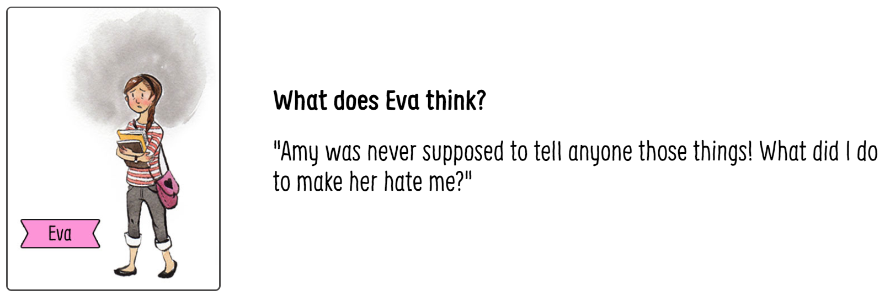

Slide 15
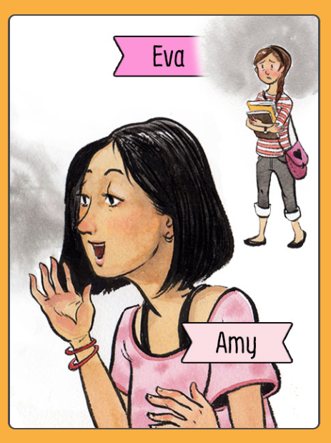
What can Amy do to repair her friendship with Eva?
In groups or individually, you have 1 minute to think of 3 ways to solve this.

Slide 16
Class Discussion
1. Share your best idea with the class
What's the biggest problem Amy and Eva face if they want to stay friends?
If they do nothing, what will happen next?

Slide 17
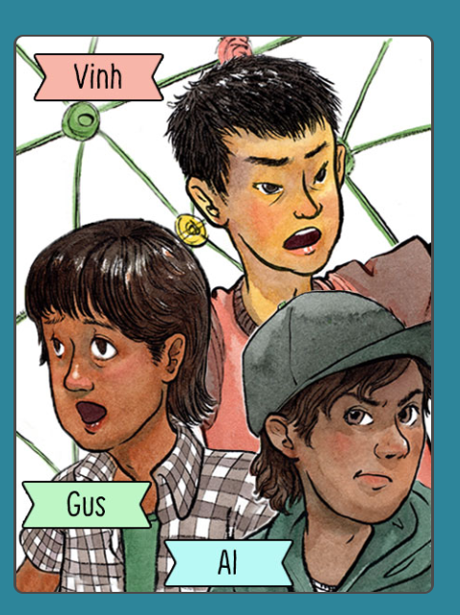
Scenario
Gus is friends with Vinh and Al, but Vinh and Al don't like each other. Gus is always being forced to choose between the two, and it's stressing him out.
Click below to see what they're thinking.
Vinh
Gus
Al

Slide 18
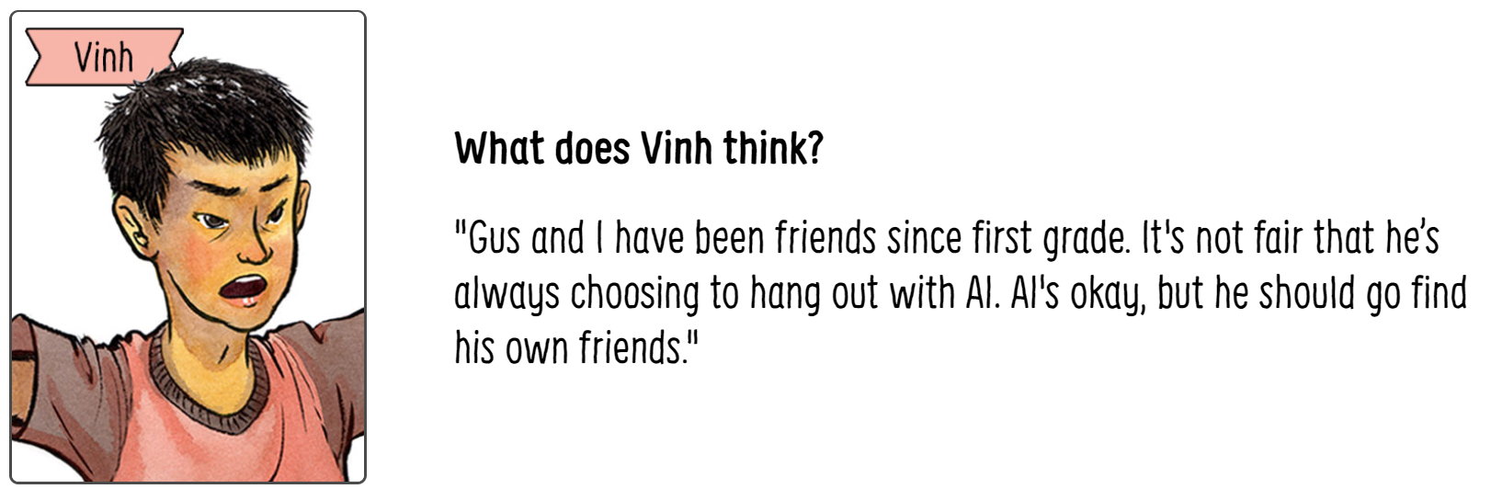

Slide 19
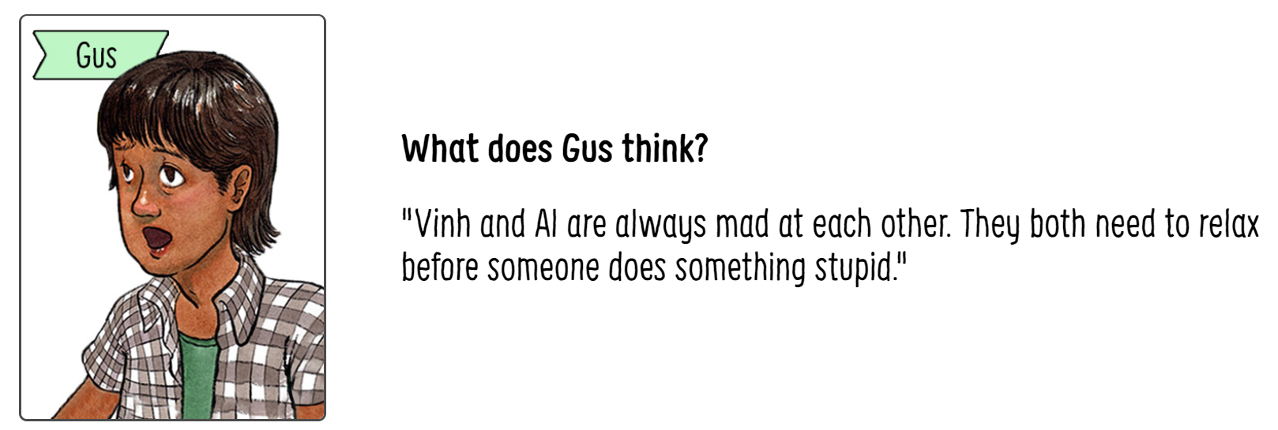

Slide 21
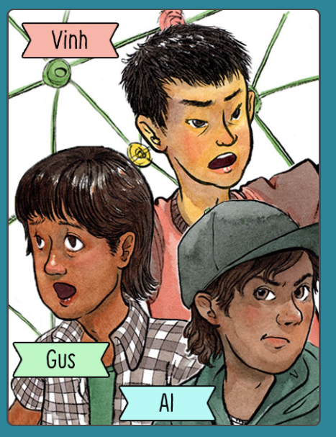
How can Gus help Vinh and Al get along?
In groups or individually, you have 1 minute to think of 3 ways to solve this.

Slide 22
Class Discussion
Share with the class your best idea
What's the biggest problem Gus faces if he wants to stay friends with both Vinh and Al?
3. If Gus does nothing, what will happen next?

Slide 23
Wednesday Healthy vs Unhealthy Relationship Kahoot

Slide 24
Video
Health vs. Unhealthy Relationships
https://play.kahoot.it/#/k/a5df1d67-7147-40cd-bac3-1e0e077ae206

Slide 25
Video
100 year old best friends
https://www.youtube.com/watch?v=73ZzBcjVcrk

Slide 26
Thursday Relationships Change

Slide 27
Collaborate
Studies show that adults change their social groups about every 7 years.
Teens change their friend groups too.
How have your friend groups changed?
Were you okay with the change? Why or why not?

Slide 28
Video

Slide 29
Class Discussion
Sometimes relationships change because people's identities or interests change.
Have any of your relationships changed for these reasons?

Slide 30
Friday

Slide 31
Collaborate
Describe your experiences with one or both of these types of situations:
1. My friends were participating in activities I didn't enjoy anymore, so I stopped hanging out with them
2. I began participating in activities my friends weren't interested in, so we drifted apart

Slide 32
Class Discussion
Sometimes when a friendship changes or ends, it feels okay.
Other times it can feel bad to lose a friend.
1. What are some ways you can cope when this happens?

Slide 33
Survey
Survey
says ….
Raise your hand if you have ever used of these strategies.
don’t blame yourself | work to meet new friends
open up to new experiences | treat former friends with respect

Slide 34
Video
https://www.youtube.com/watch?v=OoHdwUEfBts

