Slide 1
SEL Lesson –Empathy
2/4 -2/8

Slide 2
Overview
Empathy is the foundation of all emotional intelligence. By helping children learn empathy, we raise the odds they will have strong positive social relationships, truly care for others, and be able to set appropriate limits in their own lives without using angry behaviors or words.
Empathy is the heart of a great school and classroom culture.

Slide 3
Objective
understand empathy
practice ways to be more understanding
reflect on the effects of empathetic listening

Slide 4
Teacher Notes
Tuesday’s activity can be expanded by having the students put information on a shoe.
I will collect finished shoe/worksheets to put on the bulletin board in the hallway.

Slide 5
Monday Developing Empathy

Slide 6
Vocabulary
empathy [ (noun) the understanding of or the ability to identify with another person's feelings or experiences

Slide 7
Collaborate
What does it mean to put yourself in someone else’s shoes?
Do you think you’re an empathetic person?

Slide 8
https://youtu.be/zJMCctR8ivc

Slide 9
Class Discussion
What type of emotions did you feel when you watched the video clip?
Could you tell which students felt “empathy” for August?
Take the survey on next slide to see how empathetic you are?

Slide 10
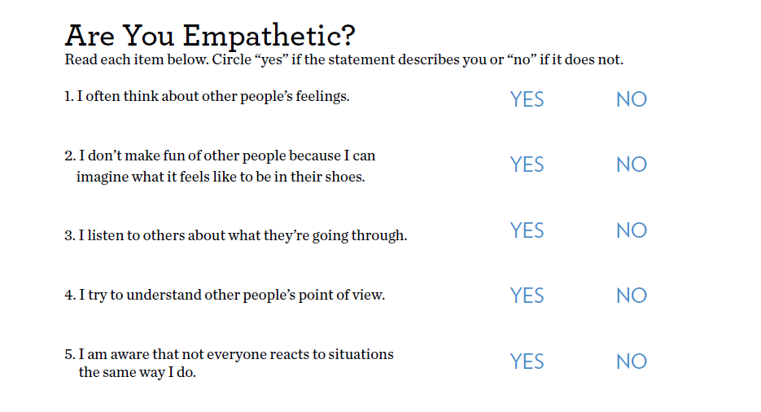

Slide 11
Results
If you answered mostly “yes,” you probably do a good job of showing empathy toward other people.
The statements you answered “no” to are things you could do to be more empathetic.

Slide 12
Tuesday In My Shoes

Slide 13
You Would Not Know This About Me, Unless You Walked in My Shoes
As a community & school we have a lot in common. We all live here, and our lived experiences are shaped by that. We’re also unique with different experiences, talents, and struggles
Directions:
Fill out a “Things You Would Never Know About Me” paper
2. Turn the paper into your teacher
3. Remember the paper is anonymous – do not write you name on paper

Slide 14
Things You Would Never Know About Me, Unless You Walked in My Shoes
This activity is anonymous. Don’t put your name on it!
List three most people don’t know about you
1.
2.
3.
What people misunderstand most about me is:
Biggest hope?
Biggest fear?
One thing I wish I could change is:
Follow link for Word Document
http://selmatters.weebly.com/uploads/1/2/0/5/120562389/things_you_would_never_know_about_me.docx

Slide 15
Walk in my Shoes Template
The goal is not to write down the obvious like, “I like football”, but more unique things about your life.
Here are some questions that may spark some ideas:
*Family? Brothers? Sisters?
*What are some unique things about your family?
*Likes and dislikes
*Talents
*Inspirations
*Favorite places?
*What do you want to be when you grow up?
*Have you ever met anyone famous?
*Funny things
*Idols?
*Serious items?

Slide 16
Wednesday

Slide 17
Optional Activity
Choose a shoe template
Fill in shoe with information from your “Things You Would Never Know About Me” paper
Decorate your shoe to fit your personality
Remember this is anonymous, do not put your name on it

Slide 18
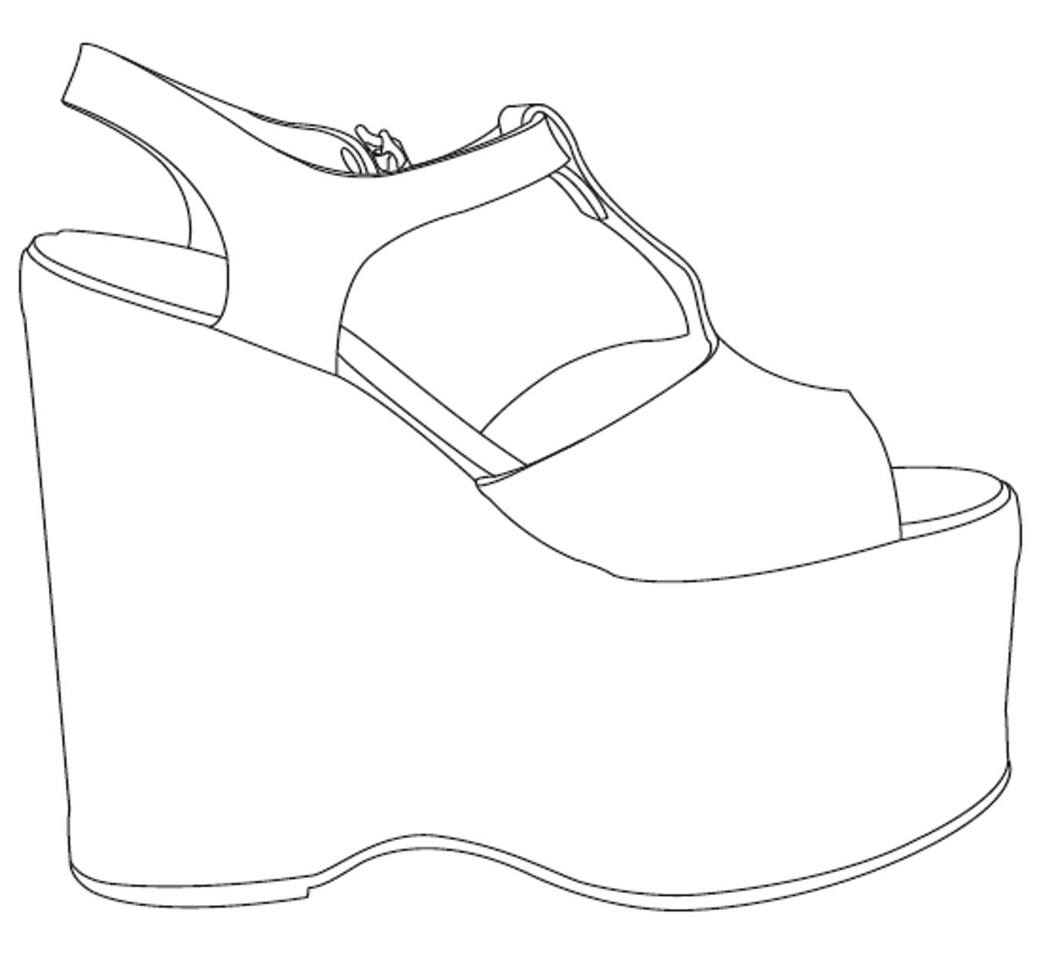
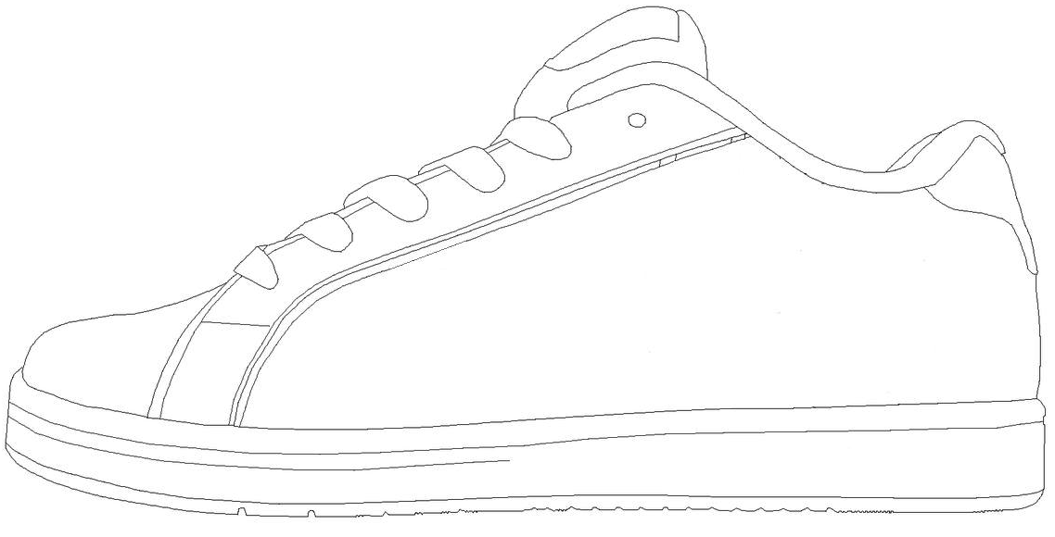
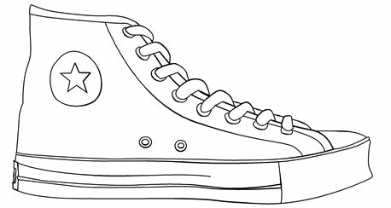
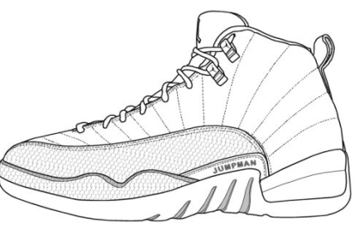
Thursday Empathy vs Sympathy
Click on the link for shoe templates
http://selmatters.weebly.com/uploads/1/2/0/5/120562389/template.docx

Slide 19
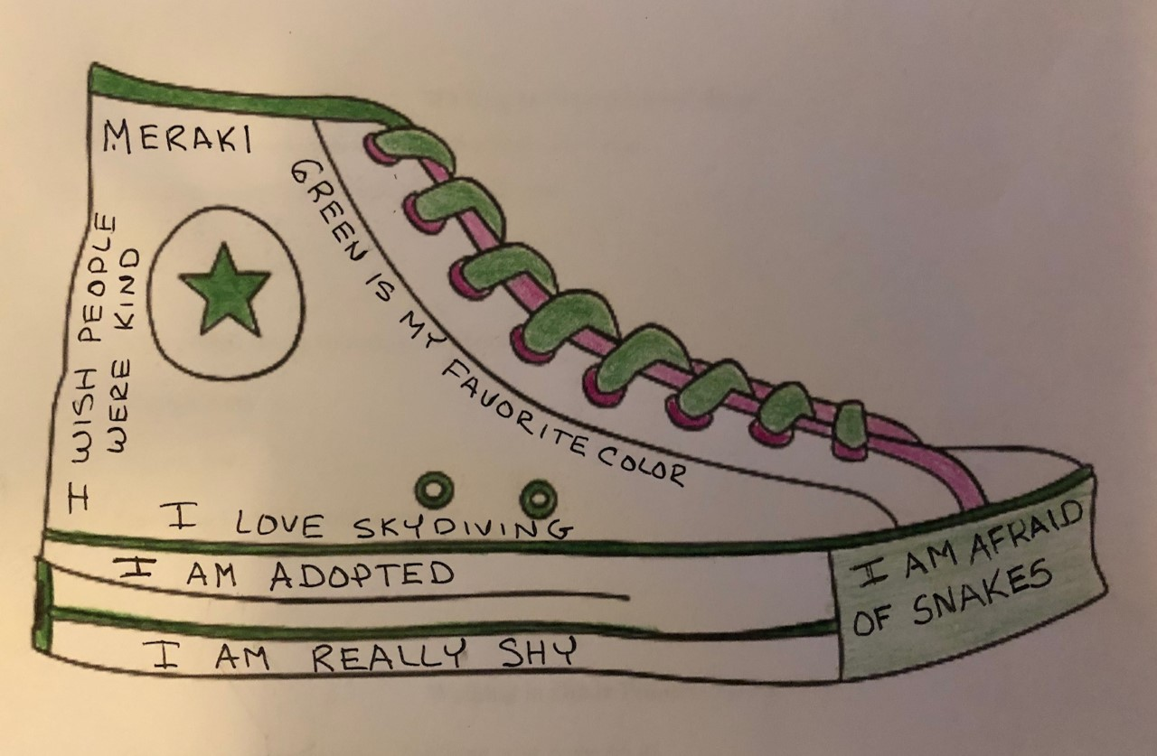

Slide 20
Thursday

Slide 21
Class Discussion
Randomly pass out the “Things I wish You Knew About Me” papers or shoes
Allow 5 minutes for students to SILENTLY look over papers and pass around.
QUESTION 1: All of our shoes (lives) are a bit different. What is one difference you notice between the activity sheet you completed and the one you received? What is one thing you had in common?
QUESTION 2: What might it be like to walk in the shoes of the person who completed the activity sheet you’re holding?

Slide 22
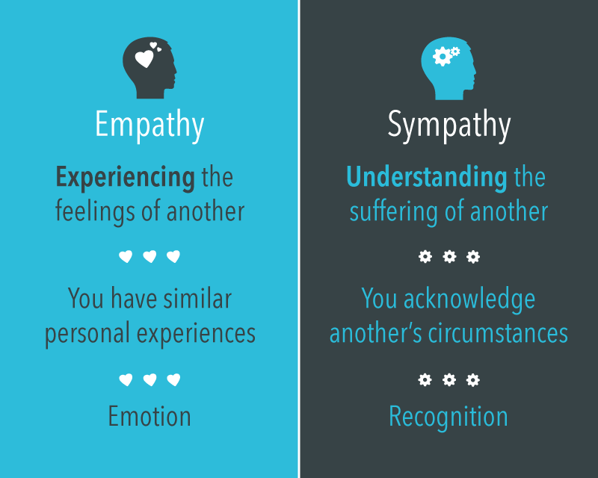

Slide 23
https://www.youtube.com/watch?v=D2sgbzSm5Cs&list=PLjd8Sthozx8VhVOtD4U6eajcNJpVt92DJ&index=6

Slide 24
Friday Bystander Effect

Slide 25
Video – The Bystander Effect
https://www.youtube.com/watch?v=Wy6eUTLzcU4

Slide 26
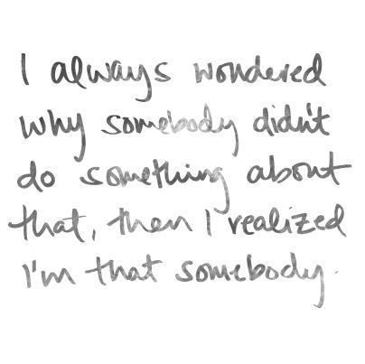
Class Discussion
What does it mean to be a bystander?
Have you ever been a bystander, explain?
What can you do to make sure you are not a bystander?

Slide 27
Optional Video & Activities

Slide 28
https://www.youtube.com/watch?v=1Evwgu369Jw&t=91s

