Slide 1
Social Emotional Learning
*Lessons for 10/29 – 11/02

Slide 2
Overview
Emotional knowledge is a powerful part of what students learn in the Social Emotional Learning. Students need to understand that although emotions provide important information, fast, emotional reactions can lead them to act in ways they’ll regret. This helps prepare students to think about the decisions they make rather than react to their emotions.

Slide 3
Objective
Analyze how emotions affect decision making
Identify why adolescents’ emotions are especially intense

Slide 4
Monday

Slide 5
Collaborate
In one word, describe how you’re feeling today.

Slide 6
Class Discussion
As a class, discuss one or more of the following prompts, as time allows:
Why are you feeling the way you feel today? Tell us about something that makes you happy. Describe why it makes you happy.
Tell us about something that makes you angry. Describe why it makes you angry.
Have you ever cheered someone up who was feeling sad? How did you do it?

Slide 7
Tuesday

Slide 8
Collaborate
What is one emotion you have had in the past to days?
Why do we have emotions?

Slide 10
Class Discussion
How can emotions affect your decisions?
How can feeling excited help you make good decisions?
How can feeling excited cause you to make bad decisions?

Slide 11
Wednesday

Slide 12
Video

Slide 13
Thursday

Slide 14
Collaborate
What are some really intense feelings you have felt recently?
Why do some emotions feel so intense?

Slide 16
Class Discussion
Click below to reveal each emotion
If you think that emotion is helpful, move to the right side of the room. If you think it’s unhelpful, move to the left
In your groups, decide why you think it’s helpful or unhelpful

Slide 20
Friday

Slide 21
Class Activity
Pick one emotion. Identify one way the emotion you choose can help you make good decision and one way it can cause you to make a bad decision.
Share with the class

Slide 22
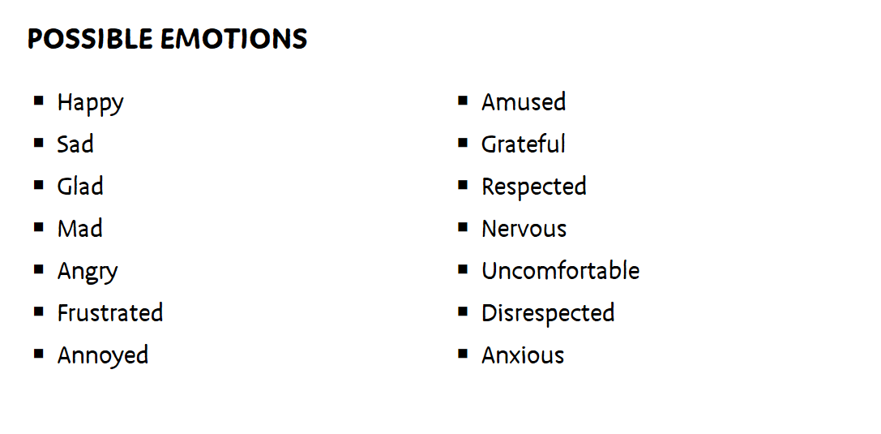
Activity

Slide 23
Optional Video & Activities

