Slide 1
Social Emotional Learning
Holiday Peace & Kindness
*Lessons for 12/10 – 12/14

Slide 2
Overview
The holidays are a time for peace, love and kindness, yet the holidays can bring loneliness, stress and anxiety for many. Peace and Kindness begins in our hearts and our minds but must be fostered by the actions we take. Kindness and peace…two very simple words, but two actions that can change your world and the world around you. They are qualities that, when you practice them, bring happiness not only to others but back to you as well. Every day we have many choices to make in the way we treat other people and things. These little choices add up to big things. They define who we are as a person and our impact on the world
It also helps relieve holiday stress and anxiety.
Practice being KIND, which will in turn bring about PEACE!!!!

Slide 3
Objective
Person R.A.C.K (Random Acts of Kindness throughout the holiday season)
Understand the concepts of Peace and Kindness.
Understand and apply concepts of Peace and Kindness in school, home, and community.

Slide 4
Teacher Notes
Dove templated will be in each teacher’s mailbox
I have included printable R.A.C.K notes for students.

Slide 5
Monday Kindness

Slide 6
R.A.C.K
Random Acts of Christmas Kindness
Share a R.A.C.K you have done for someone else
Share a R.A.C.K someone has done for YOU
Kindness

Slide 7
Video:
https://youtu.be/nwAYpLVyeFU

Slide 8
Class Discussion
What does Kindness Boomerang mean?
What are some R.A.C.K ideas for school, home, and your neighborhood.
Be prepared to share one R.A.C.K you did tomorrow.

Slide 9
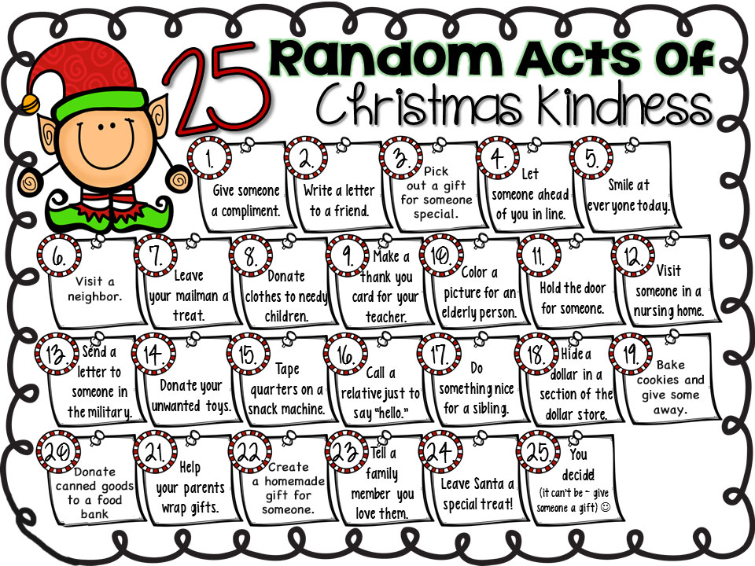

Slide 11
Tuesday Science of Kindness

Slide 12
Collaboration
Share a Random Act of Kindness you did and how it made you feel

Slide 13
https://youtu.be/O9UByLyOjBM

Slide 14
Collaborate with your partner
Pick one Random Act of Kindness & make a plan to complete you R.A.C.K
Collect R.A.C.K.’ed card from your teacher

Slide 15
Wednesday Random Acts of Compliments

Slide 16
Discussion This week we have discussed Random Acts of Kindness; how it can boomerang & make us happier Today we are going to look at how just a compliment can be an act of kindness

Slide 17
Video:
https://www.youtube.com/watch?v=-OBgdoAmuwI

Slide 18
Think of a compliment you would like to give to someone
Tomorrow you will receive a card to complete

Slide 19
Thursday

Slide 20
Collect a card from your teacher
Fill out your card
Deliver card

Slide 21
EXAMPLE
Ms. G
I love your positive attitude and humor. No matter
how stressful the day is you are always smiling! TY

Slide 22
Friday

Slide 23
Peace Doves
The dove is a symbol of peace, which we tend to think about quite a bit during the Christmas season.
But peace is important all year around.
Complete your peace dove using the prompt
I will promote peace on campus by
________________________________

Slide 24
I will promote peace on campus by ……

Slide 25
Cut out and tape in classroom to be a reminder that peace & kindness starts with YOU!
I will promote peace by being positive and respecting other teacher’s opinions & suggestions

Slide 27
Kindness and Peace !
You can choose to spread Kindness
When you go home today, act kindly toward someone in your family and do something kind in your neighborhood. Think about how those actions might start a kindness boomerang
You also can promote Peace.
Encourage others to keep kindness going in the same way that you have this week! Just imagine all the ways that you and others will make a peaceful, happier world by keeping kindness going.

Slide 28
Activities

Slide 29
Class Activity
Plan a Kindness project …
Think about someone in your family. Plan one kind act that you can do for them over the weekend.
Or- think about one act of Kindness you can do outside of school this weekend in your neighborhood.
Wrap up- have some students share their Kindness project.

