Slide 1
Conflict Management
SEL Lesson
3/4/19-3/8/19

Slide 2
Overview
This week we will continue with “Conflict Management”. Teaching students conflict management and resolution skills may provide them with necessary tools to solve their own conflict in a productive and practical way. This can also improve students self-esteem, self-confidence, and communication skills. Students will be introduced to conflict management strategies and skills.

Slide 3
Objection
Use I-statements to effectively communicate
Explore top Conflict Resolution strategies
Explore Peer Mediation

Slide 4
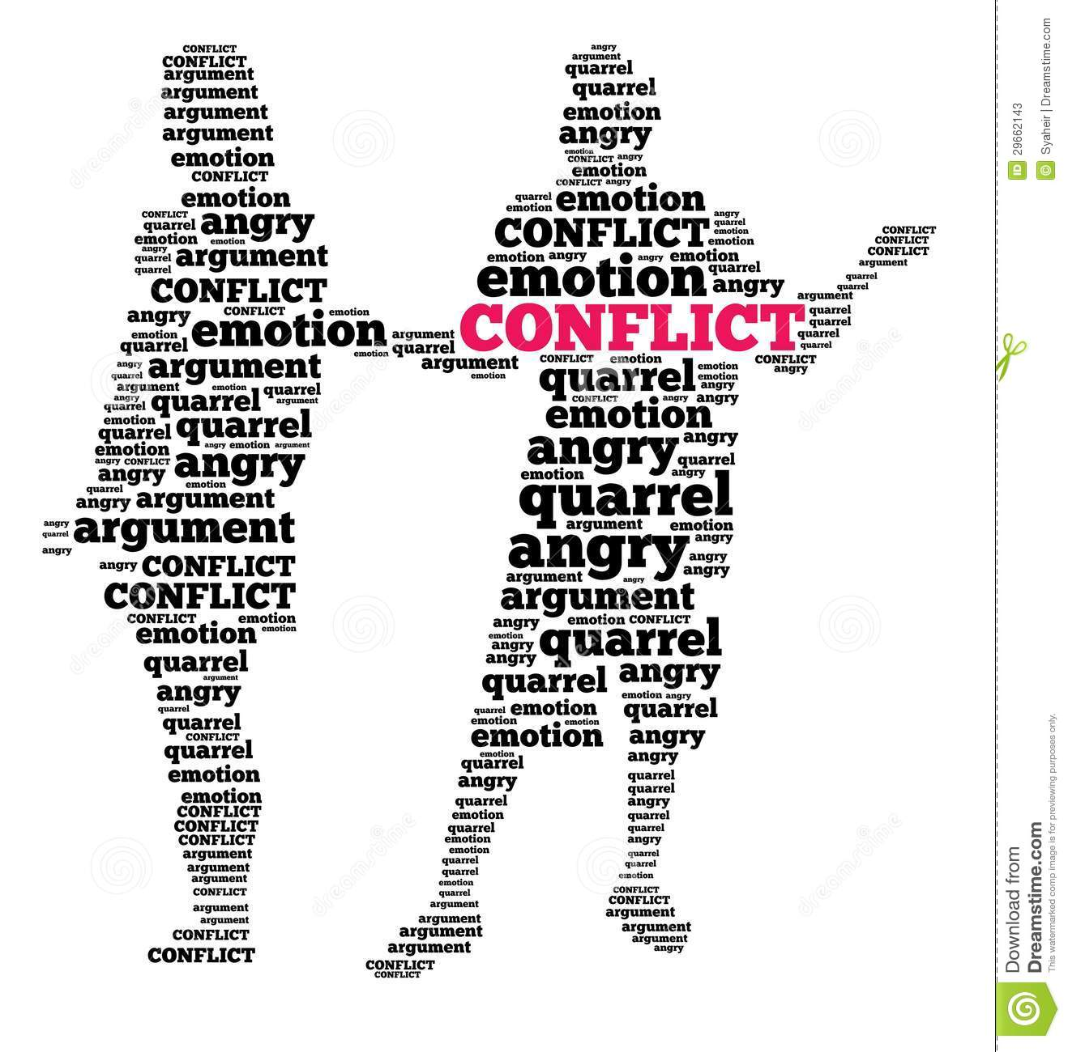
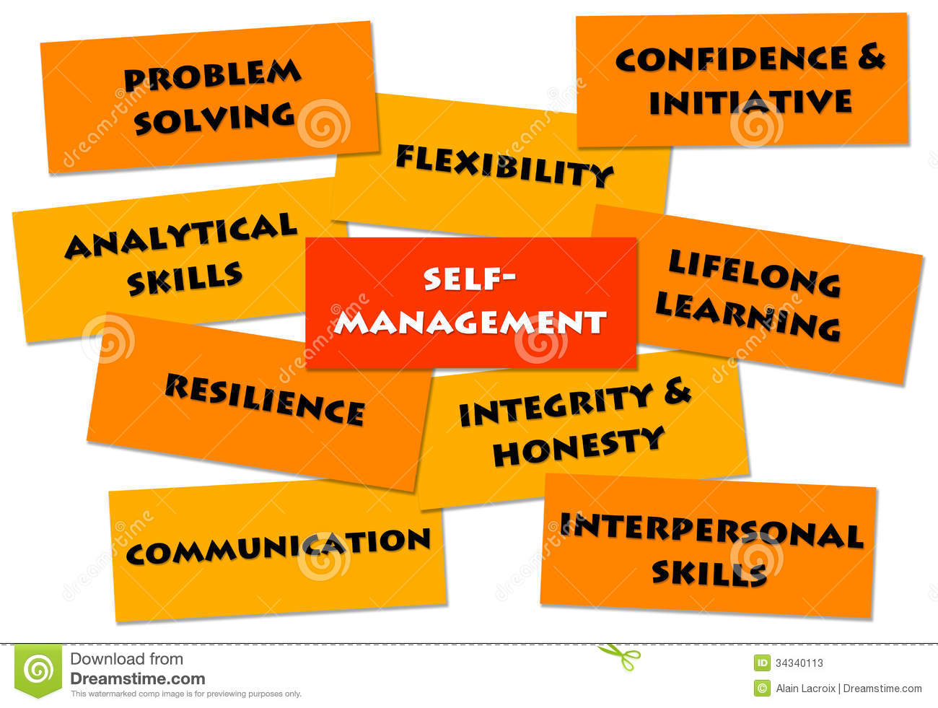
Conflicts occur when people perceive that, as a consequence of a disagreement, there is a threat to their needs, interests or concerns.
Management is the process of dealing with or controlling things or people.

Slide 5
Monday I-Statements

Slide 6
Making Connection
When you’re angry, frustrated, hurt, or fearful, the words you choose to communicate your feelings can either heighten or relieve the level of anger and intensity.
What are some words that could cause a conflict to increase?

Slide 7
https://www.youtube.com/watch?v=asjlO7ELEvc

Slide 8
I - Statements
I feel _______________________
when you __________________
because____________________
(emotion)
(event)
(thoughts about event)

Slide 9
Practice using I-Statement
A friend borrowed your Xbox controller and hasn't brought it back. You want to have it back, and he keeps forgetting to bring it to your house.
Your little brother went into your room and broke your T.V.
Your big brother invited his friends over and they made fun of you, teasing you that you are a baby.
Your friend had a birthday party and didn't invite you.

Slide 10
Tuesday

Slide 11
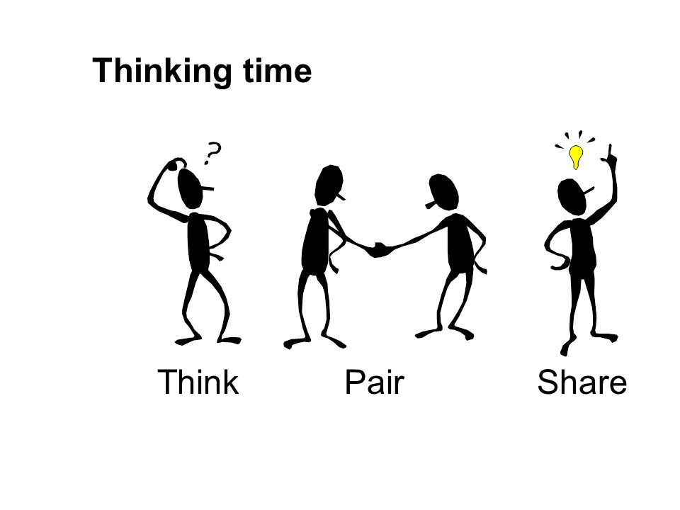
Making Connection
What strategies have you used to solve conflict?
What strategy worked best?

Slide 12
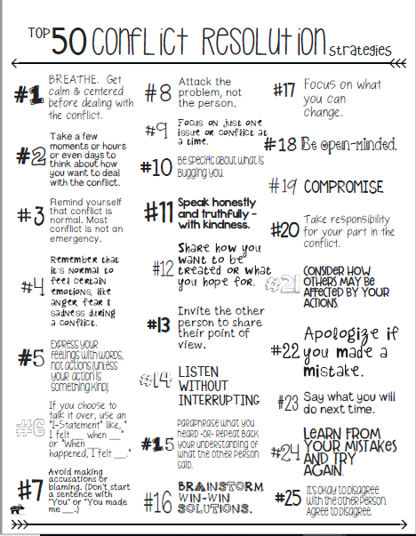
What Would You Do? Activity
Directions:
Read each conflict scenario
Use “Top 50 Conflict Resolution Strategies” to choose best conflict strategy for scenario
Share your strategy with class

Slide 13
What would you do?
You notice a group of girls who are making fun of the outfit you are wearing today. They are the same group of girls that caused problems for you last year.

Slide 14
What would you do?
You have just finished your test and walk to the teacher’s desk to turn it in. Upon returning to your desk, you discover your backpack is missing.

Slide 15
What would you do?
You are working on a group project that is worth 30 percent of your nine weeks grade. One of your partners is not doing any of the work and spends most of the time texting.

Slide 16
What would you do?
You set up the DVR to record your favorite television show. When you sit down to watch it, your brother tells you he deleted it by accident. You suspect it was on purpose because you accidently deleted one of his favorite shows.

Slide 17
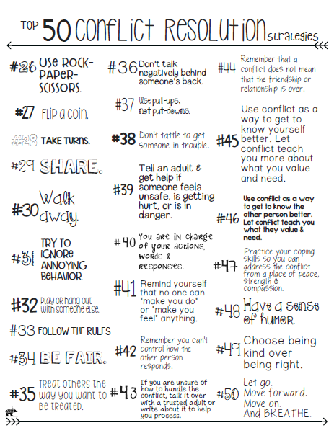

Slide 18
Thursday Peer Mediation

Slide 19
Making Connection
Have you ever helped two friends solve a conflict
What strategy did you use?

Slide 20
Peer Mediation
Peer Mediation Peer mediation is a process where youth are used to help their peers help themselves in resolving their conflicts

Slide 21
Video: Peer Mediation
https://www.youtube.com/watch?v=LoKrpuu47YE

Slide 22
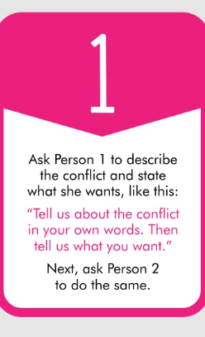
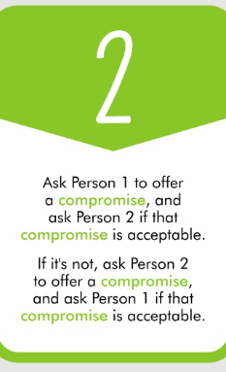
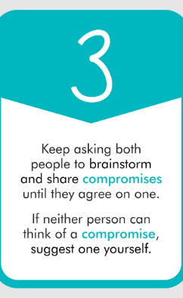

Slide 23
Optional Video & Activities

Slide 24
