Slide 1
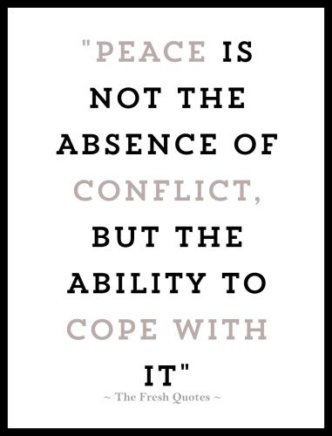
Conflict Resolution
SEL Lesson
3/4/19-3/8/19

Slide 2
Overview
This month we will focus lessons on “Conflict Resolution”. Too often, conflicts carry a negative connotation in the minds of young people. They are thought of as undesirable and primarily associated with anger, sadness and violence. Students should understand conflicts as having positive possibilities and as a necessary, natural part of life. When handled appropriately, conflicts are opportunities to make something better. They challenge us to learn, grow and create.

Slide 3
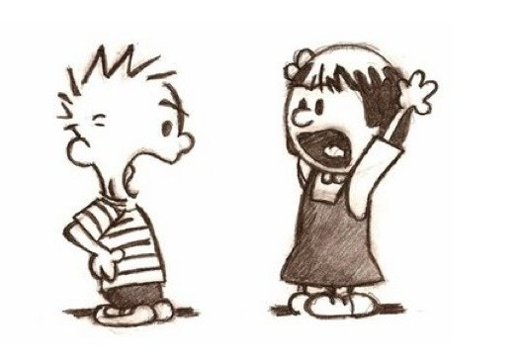
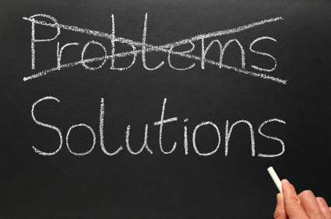
Conflicts occur when people perceive that, as a consequence of a disagreement, there is a threat to their needs, interests or concerns.
Resolution is the act of solving, or explaining, a problem, and seeking way to solve a problem.

Slide 4
Tuesday What is Conflict

Slide 5
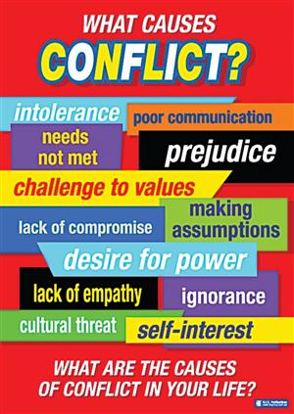
Making Connection
What are some reasons students get really mad at each other?
What are some examples of minor conflicts that can happen here at school?
What are some examples of serious conflicts?

Slide 6
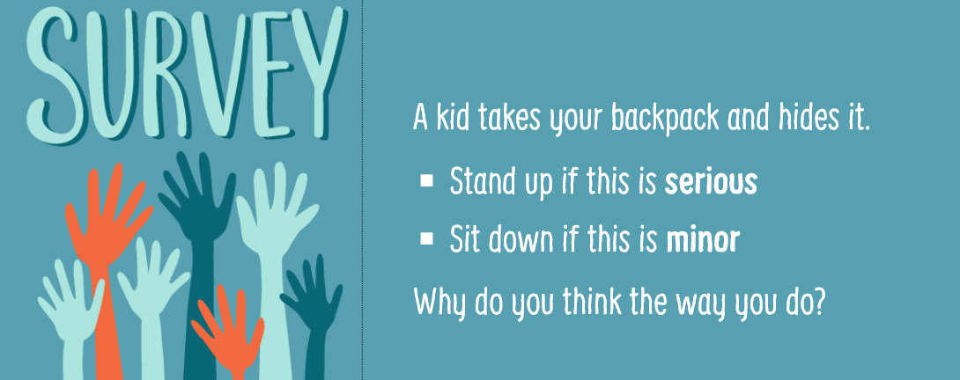
MINOR

Slide 7
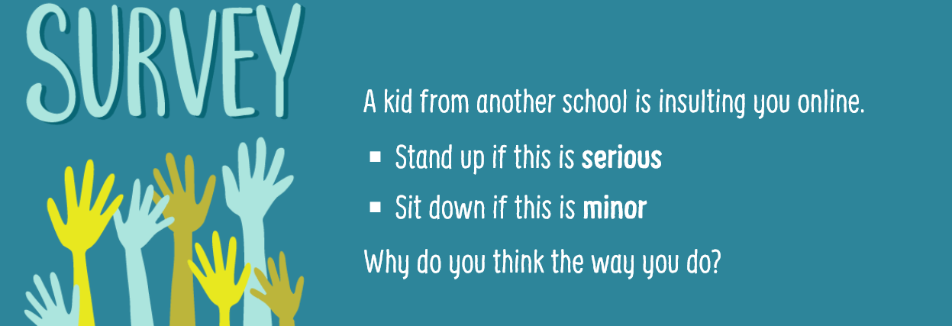

Slide 8
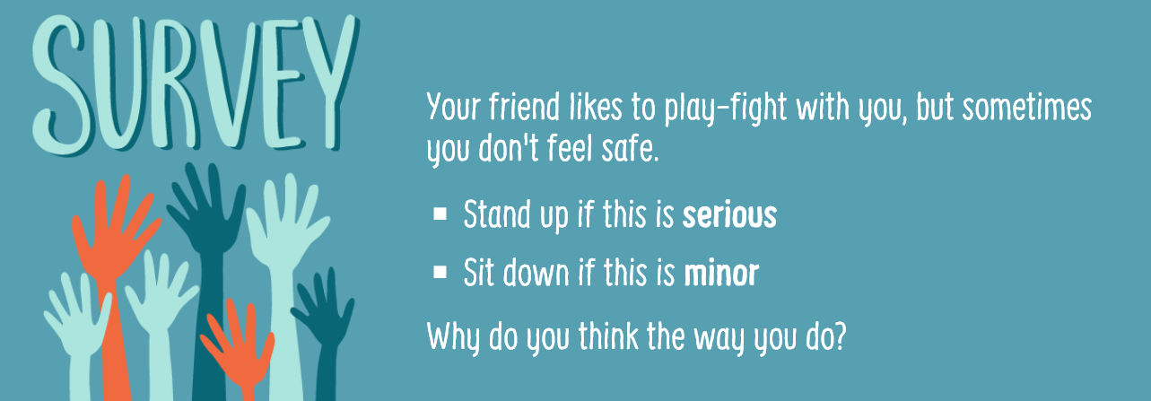

Slide 9
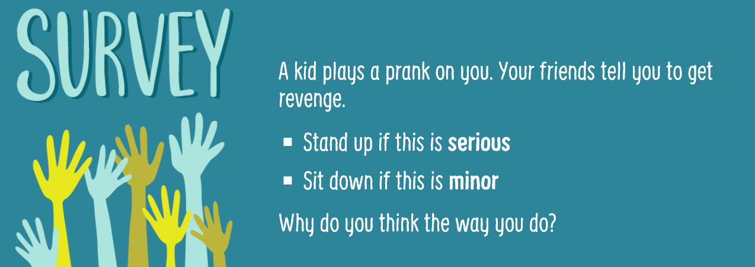

Slide 10
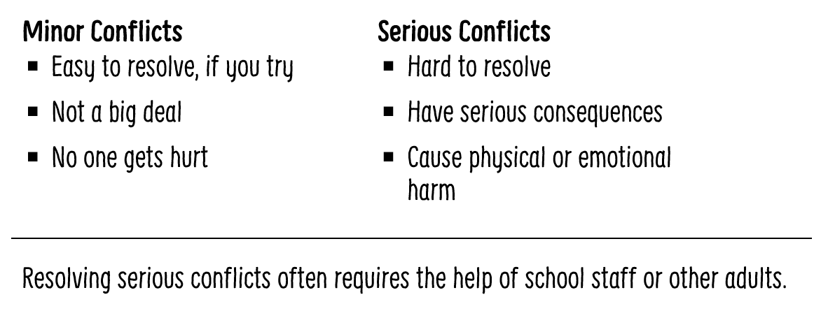

Slide 11
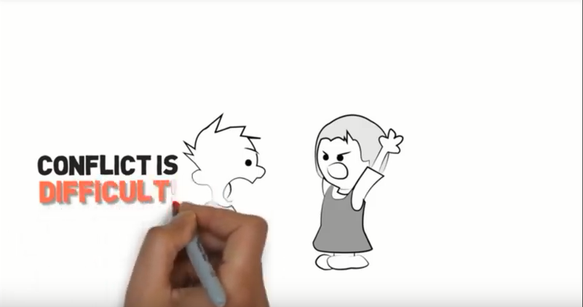
https://www.youtube.com/watch?v=_wzbbgzgaDs

Slide 12
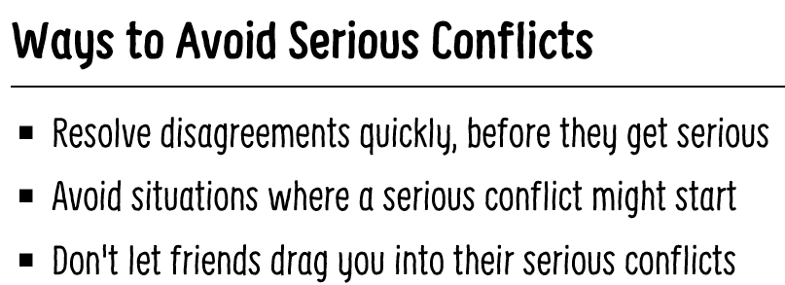
Class Discussion
How can a minor conflict turn into a serious conflict?
How can a serious conflict affect you?
How can it affect the people around you?
What are the benefits of avoiding serious conflicts?

Slide 13
Wednesday Conflict Resolution

Slide 14
https://www.youtube.com/watch?v=ghk-nDJB3Tk

Slide 15
Kid President: “How to Disagree”?
What are some things you can do to disagree without being “MEAN”?

Slide 16
Thursday How to Disagree

Slide 17
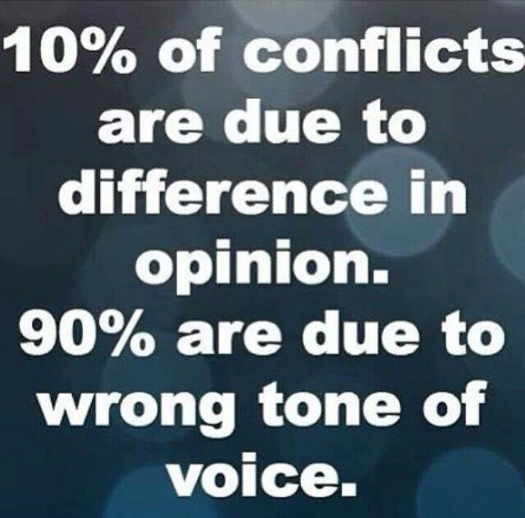
Making Connection
Everyone gets into conflicts. It happens when you want something, and another person wants something else. How well can you resolve a conflict?
Your attitude has a lot to do with it.

Slide 18
Video: Conflict Resolution
https://www.youtube.com/watch?v=EABFilCZJy8&t=88s

Slide 19
Four types of attitudes and how they each resolve conflicts.
Competitive
I WIN/YOU LOSE
Never give in.
It’s not enough that you win, the other person has to lose.
Passive
YOU WIN/I LOSE
Always give in.
To keep the peace, you ignore your
own needs.
Accommodating
I LOSE/YOU LOSE
Usually give in, but figure out a way to sabotage the other person.
You don’t really care if you win, as long as the other person loses, too.
Collaborative
I WIN/YOU WIN
Compromise in order to get most of what you want.
You stand up for yourself, but you want the other person to be satisfied, too.

Slide 20
Class Discussion
Which of these attitudes is best for resolving conflicts so that they stay resolved? Why?
Which of these attitudes is the hardest to deal with? Why?
Which attitude is the hardest one to keep if you are in a conflict? Why?
Which attitude are you mostly likely to exhibit while in conflict.

Slide 21
Friday What conflict strategy would you use?

Slide 22
https://www.youtube.com/watch?v=ylzqhpU4WyQ

Slide 23
Class Activity
All of us will encounter conflict on a daily basis but it is how we react that determines the outcome. If we act disrespectful or unproductive then people may view us as mean or immature. If we act positive people will want to be around us.
For each of the following scenarios, decide if the conflict strategy they used was positive or negative.
If the strategy was negative, use the Conflict Resolution Strategy sheet to find an alternative strategy.
Share with the class

Slide 24
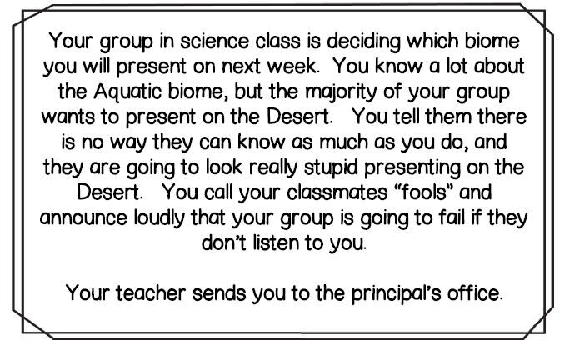

Slide 26
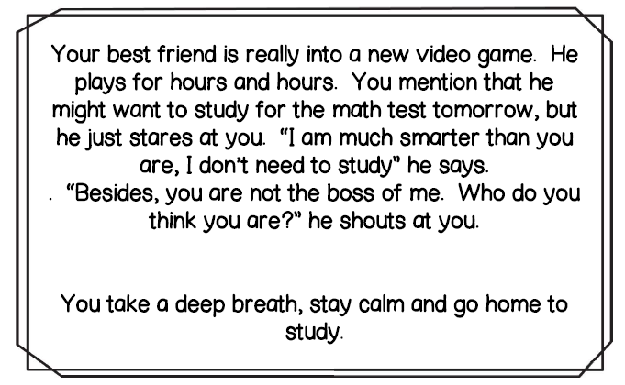

Slide 27
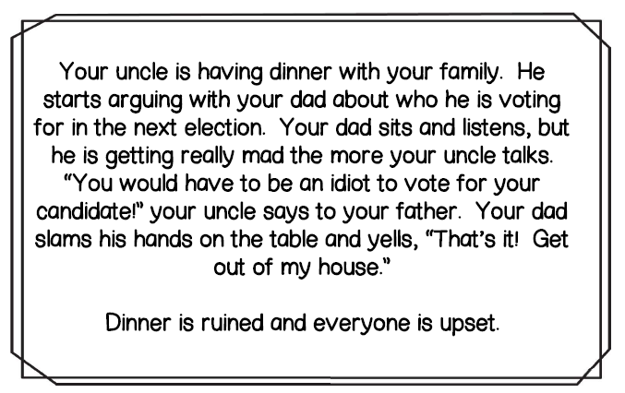

Slide 28
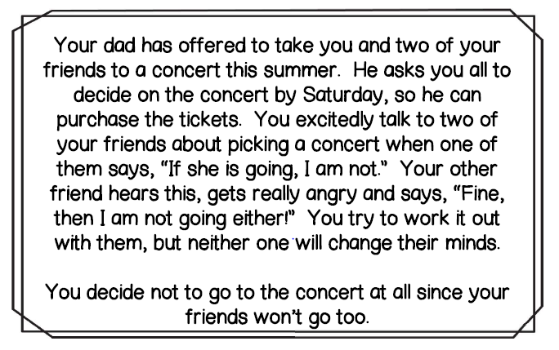

Slide 29
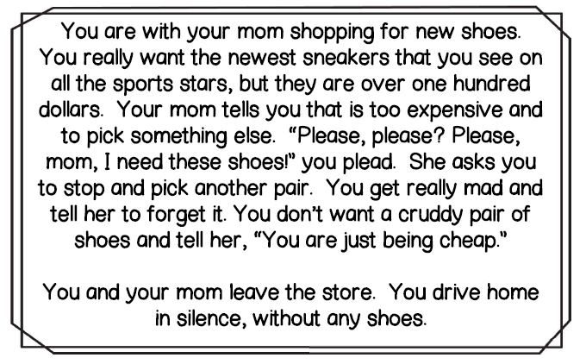

Slide 30
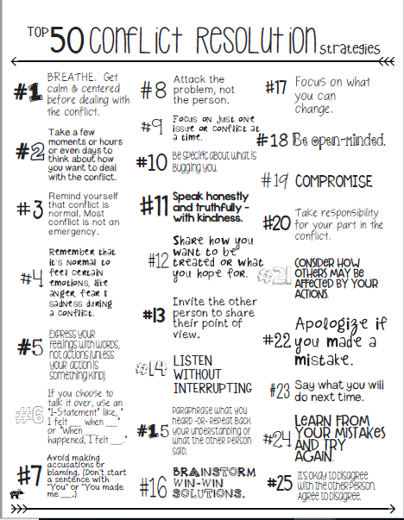
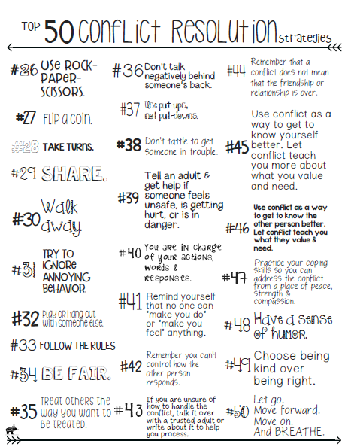

Slide 31
Optional Video & Activities

Slide 32
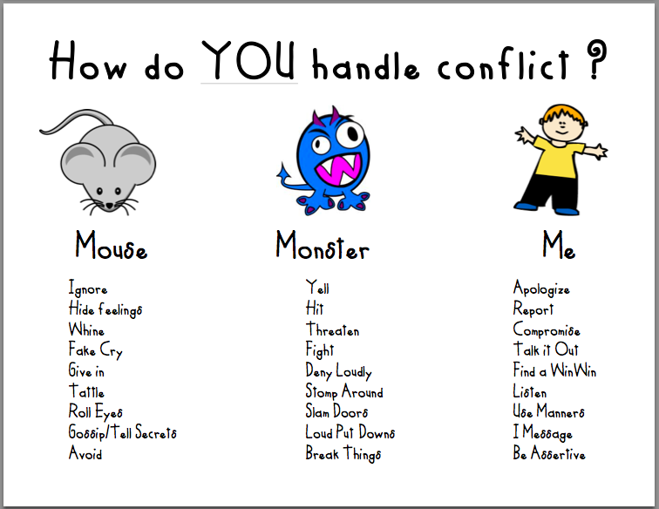

Slide 33
https://www.youtube.com/watch?v=ylzqhpU4WyQ&t=64s

