Slide 2
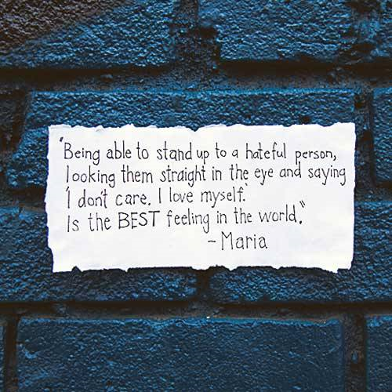
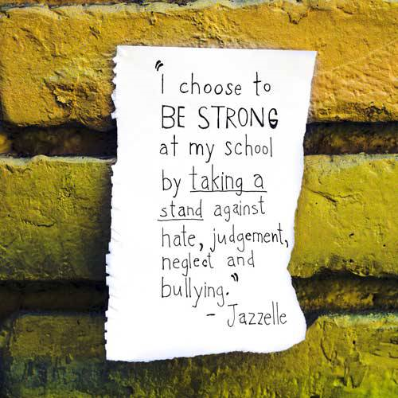

Slide 3
Overview
October is Bullying Awareness Month. Everyone knows that bullying situations involve the student who's targeted and the student doing the bullying. This week we are focusing on encouraging students to be an effective bystander and different ways to respond to bullying situations.
Bystanders are powerful. In fact, more than half of bullying situations will end if bystanders take action. Direct confrontation is one way to intervene, but is recommended only if its feels safe to do so. Indirect help — such as not encouraging the situation or offering support to the person being bullied — is also effective. The most powerful acts to take are giving support to the person being bullied. Bystanders can also let other students know that bullying is not okay.
We need to start equipping and empowering youth to ignite change in peer behavior.

Slide 4
Monday What is an Ally?

Slide 5
Collaborate
Being an ally means supporting someone who is dealing with something difficult.
Tell us about a time you were an ally and helped someone else.

Slide 6
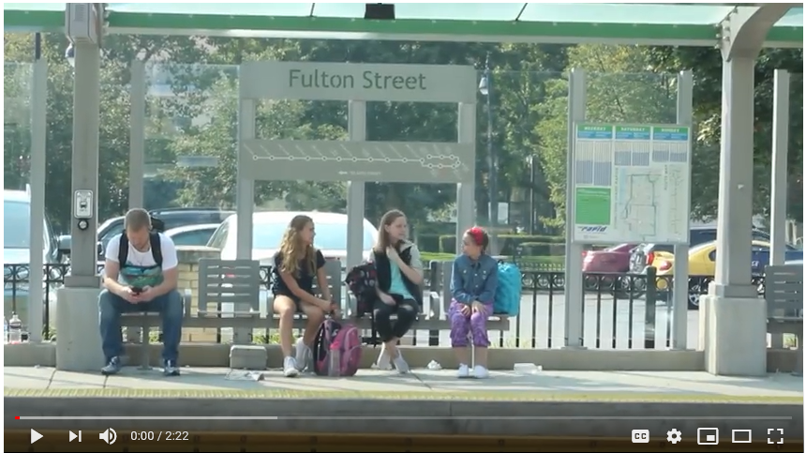
https://youtu.be/PqU-hnowpZA

Slide 7
Class Discussion
How do you feel when you see other people being bullied?
People who are bullied often need an ally. What are some small things you can do to be an ally to someone who is being bullied?
How could being an ally to someone who is being bullied help make school a better place for everyone?

Slide 8
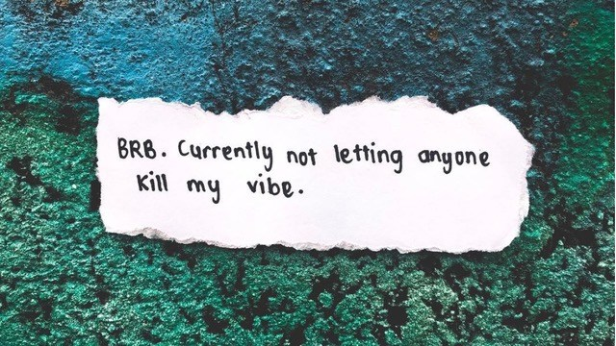
Tuesday Body Shaming

Slide 9
Body Shaming
Perhaps the most common form of bullying is what’s become known as “body shaming.”
This involves making fun of our bodily imperfections or differences, with insults like
fatso,
Dumbo
four-eyes
pizza-face
Ginger
just plain ugly.
There is no end to the kinds of insults that can be made about our bodies.

Slide 10
So, we may not be able to change our body so it won’t be made fun of, but you can quickly and easily stop people from repeatedly insulting you, regardless of what our body is like. Here are some examples
Insulter: You look like a giraffe!
Me: Yes, I can see the ocean from here!
Insulter: You are so fat, you look like a hippopotamus!
Me: You are so skinny! That’s great!
Insulter: Hey pimple-face! You look like a pizza!
Me: You have such great skin! You should be a model!
Insulter: Your ears are so big!
Me: Yes, I use them to fly with!
Insulter: Your hair is so red!
Me: Your hair is so brown!
Insulter: You are so ugly!
Me: And you are so handsome/beautiful!
With such responses, people will feel foolish picking on you and will quickly stop.

Slide 11
Conclusion
So, if you’re being body shamed, stop thinking it’s because there’s something wrong with your body. Every one of us, no matter how beautiful or perfect, has things about us that could be made fun of.

Slide 12
Wednesday “WE WILL” Generation

Slide 13
Collaboration
Are you an “Upstander” or a “Bystander” when you see someone being bullied?
https://vimeo.com/101641597

Slide 14
Video
https://www.youtube.com/watch?v=0l4nJeh6iDU

Slide 15
Class Discussion
What are some positive ways bystanders can help end bullying?
What are some negative ways bystanders can contribute to bullying?
What could you do as a bystander when you see physical bullying?
What could you do as a bystander when you see verbal bullying?
What could you do as a bystander when you see cyberbullying?

Slide 16
Thursday
Generation Against Bullying

Slide 17
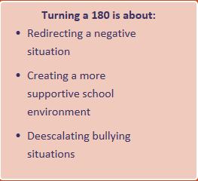
“You will be the generation that says: this is our issue and we will be the solution.”
A friendly word or gesture is all it takes to stop a bully, and anyone can do that. If an upstander witnesses bullying and becomes involved in a non-threatening manner, the bullying stops in less than 10 seconds 85% of the time.
Replace negative messages with positive actions that demonstrate inclusion and that it’s ok to be who you are.

Slide 18
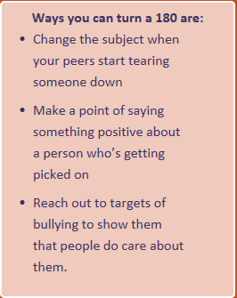

Slide 19
Activity
What can you do to? The whole class is starting to turn on this girl. How can you divert this situation
Situation #1 During class your teacher announces the winner of the science fair – a quiet, intelligent girl who doesn’t have many friends. Immediately a bunch of your classmates start mocking her, joking about how she’ll never get a date to prom unless she makes one in the lab herself. You can see that this girl is getting really upset. You feel awful – she should be able to celebrate her big win.
Example #1

Slide 20
Activity
What can you do to? The whole class is starting to turn on this boy. How can you divert this situation
Example 2 As you walk into class this morning, you notice one of your classmates staring fixedly at his desk with his fists clenched. When you get closer you realize that someone has written “retard” on his desk. You feel sick to your stomach. Earlier this year, he had explained to the class that he has Autism and sometimes he does things a little differently. Your classmate starts rocking back and forth, like he does sometimes when he gets anxious. Across the room, a group of guys start mocking him, throwing their bodies violently back and forth and laughing at him. You know this classmate is kind and smart, but it seems like no one really cares about that right now. Other students in the class start joining in making fun of him, but others, like you, just look uncomfortable and sad. You wish someone would speak up…but no one does.
Example #2

Slide 21
Situation #1:. You’re not sure that you’re brave enough to tell them off for making fun of her…but maybe there’s a way for you to divert the situation. You take another look at her project, on display in the front of the room, and realize that it’s actually a pretty cool cell-phone-controlled robot. You start talking loudly to one of your friends about how cool it is, and ask the inventor if you can try it out. Pretty soon the rest of the class shifts their attention to watching the robot zoom around the classroom. Now everyone is focused on this girl’s amazing invention, rather than on tearing her down.
Situation #2: How could you help your classmates find the courage to speak up? You know that this classmate loves Spiderman, and you happen to have seen the new movie this weekend. You take a deep breath, sit down next to him, and ask him if he saw the movie too. As the two of you start talking about how great it was, he stops rocking and his fists unclench. For the first time that morning, he looks relaxed and happy. Other classmates join in the discussion, and pretty soon most of the class is engaged in a lively debate about whether or not Peter Parker invented selfies.

Slide 22
Friday
I How to Inspire Confidence in Yourself and Others

Slide 23
https://youtu.be/e-IdVaruy0A

Slide 24
Activity
Today we’re going to write down all of the hurtful things people have said to us and then get rid of those things. Then we’re going to reflect on the way we want people to look at us.

Slide 25
Activity
Have students write down hurtful things people have said about them in the past. Reassure students that no one will see what they write.
After students have completed their lists, have them rip up their sheets of paper and deposit the shreds in a recycling bin.
On a new sheet of paper, have students write their names and a list of ways they would like others to describe them. These could include things they do well, important facts that few people know about them, or personality traits they’re proud of.
Have students decorate their lists. Post the lists in the classroom.

Slide 26
Video – What would you do?

