Slide 1
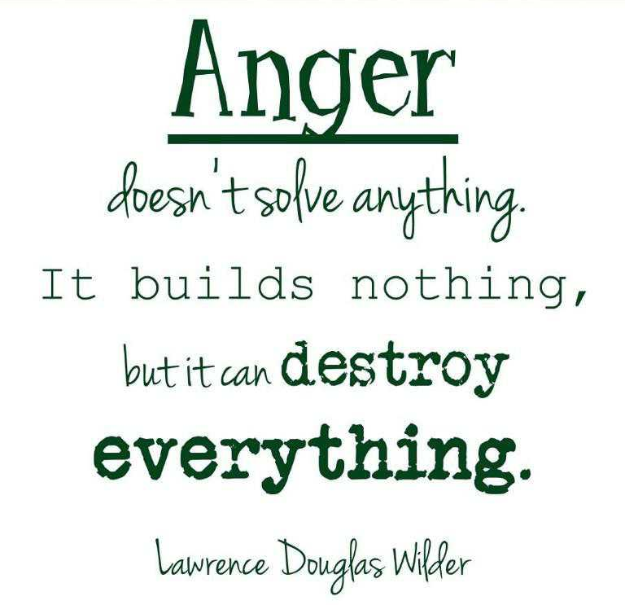
What Sets You Off
Anger Management
4/15 - 4/19

Slide 2
Overview
According to the American Psychological Association, when a adolescents anger gets out of control and turns destructive, it leads to problems at school, in personal relationships and in his overall quality of life. Teens with difficulty managing their anger effectively tend to respond with verbal and physical aggression.
Anger management techniques can help build teens' awareness of anger and improve their ability to implement better self-control skills. For anger management to be successful, it's important for teens to be accountable for their anger and avoid blaming their emotions on other people or events.

Slide 3
Objective
to enable students to describe anger and its effects on them
to transition students from inappropriate action when angry to more constructive behavior
to give students options with which they can cope with their anger

Slide 4
Vocabulary
Anger: a person’s response to a threat to himself or in a group with whom he identifies. Those threats can be either physical or psychological (“dissing” someone)
Aggression: a behavioral act that results in harming or hurting others

Slide 5
Monday

Slide 6
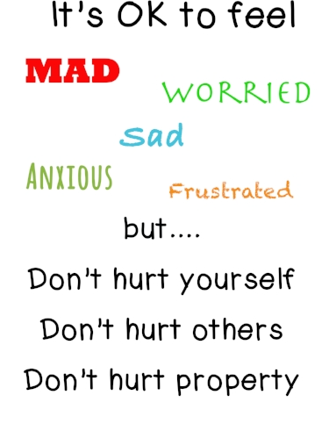
Making Connection
“He who angers you conquers you”
Elizabeth Kenny
Think of the last time you got angry
can you identify where the anger came from
did the angry feeling have a synonym (frustration, sad, disappointment)
What happened when you got angry?
What are some negative things you do when your angry?
What are some positive things you do when you angry?

Slide 7
Video
https://www.youtube.com/watch?v=d_5DU5opOFk

Slide 8
Types of Aggression
Physical Aggression: entail violence such as shoving, fighting
Verbal Aggression: teasing and taunts that often can escalate into physical fight. With technology verbal aggression doesn’t have to take place in person.
Relational Aggression: refers to acts intended to destroy other people’s social status or peer relationships

Slide 9
Tuesday

Slide 10
Making Connection
“TRIGGER”—something that evokes an emotion, usually makes us MAD (angry) and causes us to get upset
1. What are some triggers that evoke anger?

Slide 11
What is the Trigger?
https://www.youtube.com/watch?v=k1oXx4delIY&list=PL1EOgA5GpMyKR-Po5_Nt6mkGfKB1KuU-4&index=6

Slide 12
What is the Trigger?
https://www.youtube.com/watch?v=3v196bt5kTU&list=PL1EOgA5GpMyKR-Po5_Nt6mkGfKB1KuU-4&index=5

Slide 13
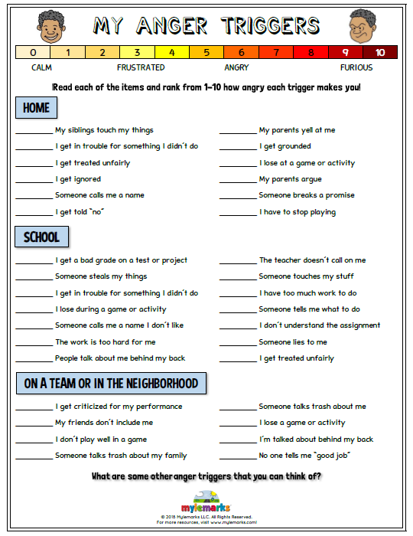
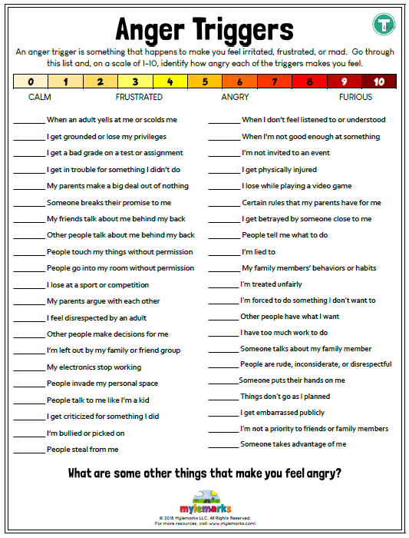
Identify your Triggers
Keep worksheet as a reference for you.

Slide 14
Class Discussions
Is there a pattern in what sets you off?
Did you get angry two or more times at the same place or time?
Did you get angry with the same person
Very often we have a problem controlling our emotions, we discover that the same sorts of behavior (teasing) or the same people act as triggers. Certain locations are often “danger zones” for anger confrontation. Identifying our triggers is the first step towards emotional management

Slide 15
Identifying our triggers allows us to take responsibility for our angry outburst as we can ONLY control OURSELVES.

Slide 16
Thursday Anger Management

Slide 17
Anger Management Tools
https://www.youtube.com/watch?v=BsVq5R_F6RA&t=1s

Slide 18
Class Activity
Pass out brochure to each student
Complete brochure individually
C

Slide 19
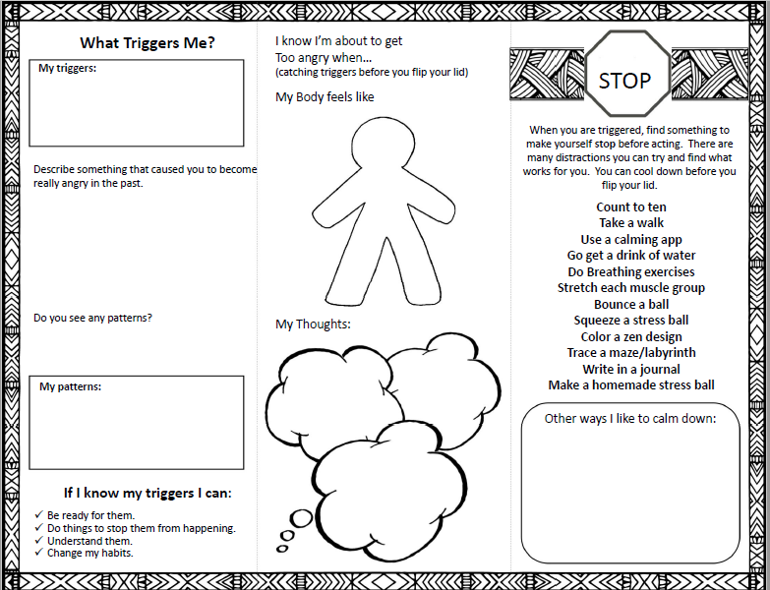
Example of possible triggers:
Being called a name, picked on
Falsely accused
Ignored, left out, feel invisible
Someone gets too close to you.
Jealousy, Fear, Not feeling in control
Describe something that caused you to become really angry in the past.
What caused it?
What happened right before it?
Did you have a good day before that or did it start off with a bad morning?
Were you hungry or tired? (physical feelings)
Who else was around you?
Where were you?
Examples of patterns:
My little brother is usually with me when I get too angry.
It only happens at home.
It only happens when I’m hungry.
It never happens when mom is home

Slide 20
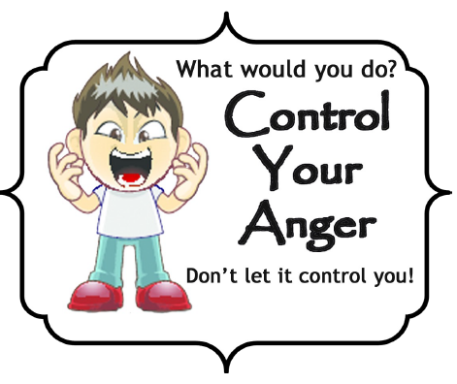
Friday

Slide 21
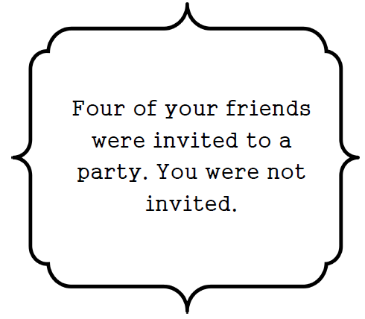
What would you do?

Slide 22
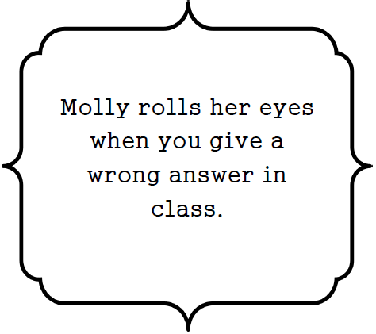
What would you do?

Slide 23
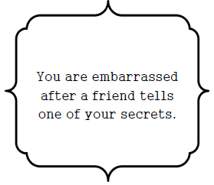
What would you do?

Slide 24
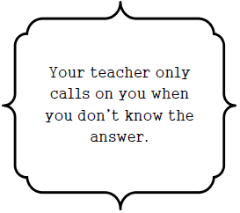
What would you do?

Slide 25
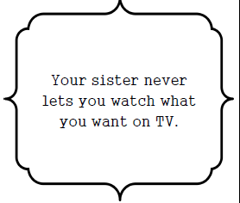
What would you do?

Slide 26
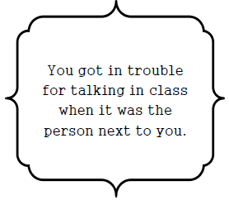
What would you do?

Slide 27
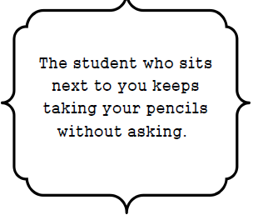
What would you do?

Slide 28
Optional Video & Activities

