Slide 1
Self – Regulating emotions
Meta – Moment Tool
*Lessons for 1/22 – 1/25

Slide 2
Overview
Last week we discussed how identify our emotions, this week we are focused on self- regulating our emotions. The lesson introduces a self-regulating tool called a “Meta- Moment.”
Emotions can either help or hinder relationships, and we all have moments that get the best of us. The Meta-Moment helps students and educators handle strong emotions so that they make better decisions for themselves and their school. The Meta-Moment is a brief step back from the situation when we pause and think before acting. We ask ourselves, how would my “best self” react in this situation? What strategy can I use so that my actions reflect my best self?
Over time and with practice, students and educators replace ineffective responses with productive and empowering responses to challenging situations.

Slide 3
Tuesday

Slide 4
Video
The Big Bang Theory - The Emotion Detection Automation
CLICK ON THE LINK BELOW FOR VIDEO
https://www.youtube.com/watch?v=TfNnpsYATbQ

Slide 5
Self -Regulation
Identifying emotions is an important step to self awareness but how do we self regulate our emotions?
What does “self – regulation” mean?
What are some ways you can self-regulate your emotions

Slide 6
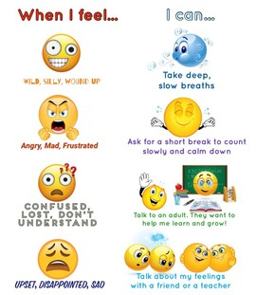
Self – Regulating Emotions
The ability to manage disruptive emotions and impulses
Involves controlling ones own behavior, emotions, and thoughts in pursuit of a long-term goal.
Self-regulation allows us to bounce back from failure and stay calm under pressure

Slide 7
Thursday

Slide 8
Collaborate
enraged
As a class brainstorm as many triggers as you can think of that might happen during a typical day with at school.
Triggers can invoke many types of emotions. Watch video below.
furious
livid
hostile
irate
aggressive
Angry
frustrated
resentful
agitated
ANNOYED
https://www.youtube.com/watch?v=t5jw3T3Jy70&t=29s

Slide 9
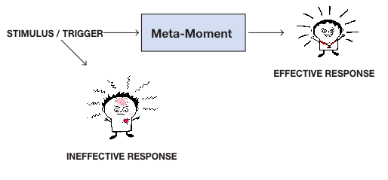
Meta-Moment
“Between stimulus and response, there is a space. In that space lies our power to choose our response. In response lies our growth and freedom.” Victor E. Frankl

Slide 10
Meta - Moment
https://www.youtube.com/watch?v=RfX1NefGeRQ

Slide 11
A meta-moment is the process for prolonging and managing the “space in time” between an emotional stimulus and response in order to promote personal well-being and both academic and professional growth.
Notes:
TIME: 3 minutes
PURPOSE: to briefly introduce the 6 steps of the Meta Moment and share a personal story for context
DO: As the facilitator, share a 2-3 minute personal story about a time when you were in the red and needed to calm down to handle the situation. Choose a family-focused example. Think about an appropriate time you were triggered. Be prepared to share the thoughts going through your head, how your body was feeling, how you calmed down, what your best self looked like, what strategies you used (or could have used) and how you were successful
SAY:
Definition: The Meta-Moment is the time between when you feel something and when you do something. This process helps us use that space to make a choice that will be effective, that will more likely have the outcome that we desire. Taking a Meta-Moment is invaluable when you need to control your impulses, want to shift your mood and strategize a solution that is more thoughtful (aligned with your values and beliefs)
There are SIX Steps to taking a Meta-Moment, although in real time it happens very quickly.
3. DO: Read the steps briefly and let participants know that you will be taking them through the entire process.
*NOTE:
1. Parents might argue that they don’t have time for Meta-Moments. What most people don’t realize is how much time they spend each day dealing with their own and others’ emotions and picking up the pieces after an ineffective response.

Slide 12
Meta – Moment in Action
1. Watch the video below
2. Identify all Meta – Moment steps in the video

Slide 13
Friday

Slide 14
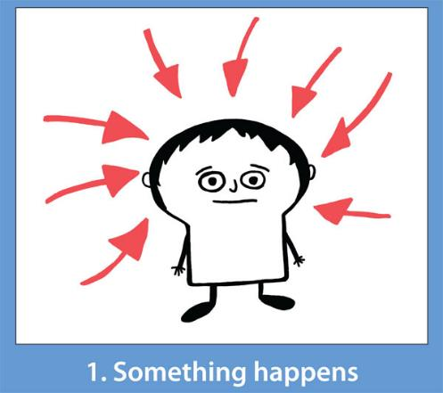
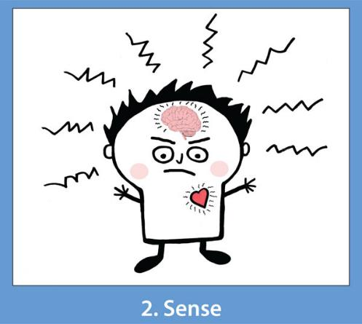
STEP 1: SOMETHING HAPPENS
Something real or imagined triggers an emotional experience
(thought, person, place, event)
Notes:
TIME: 3 minutes
PURPOSE: Explain Step 1
SAY: Let’s talk about what it means to take a Meta-Moment.
Something Happens: You recognize something in the environment that is ‘wrong’ (i.e., trigger or stimulus).
These triggers can be a result of
a thought (e.g., your anticipation about an upcoming difficult situation or person),
a person’s action (e.g., someone says something to hurt your feelings.),
a place (e.g., returning to your hometown),
an event (e.g., having to face the holidays without a loved one)
For example: Connect back to the personal story shared in previous slide, as an example (so as I shared, when my aunt ... I felt humiliated and angry)

Slide 15
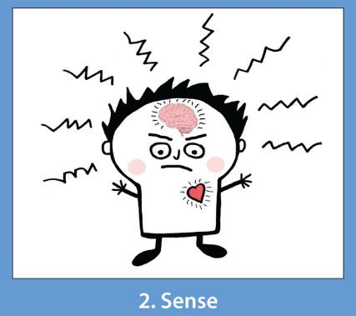
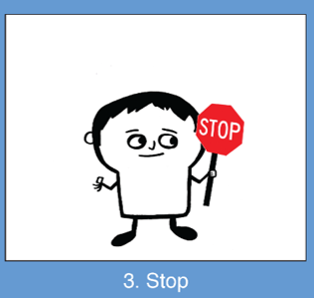
STEP 2: SENSE
You sense the shifts in:
How you are thinking
“They are all judging me.”
How your body feels on the inside
Racing heart, tension
Your facial expressions, posture, and voice
Furrowed eyebrows, clenched fist
This is your cue to take a Meta-Moment!
Notes:
TIME: 4 minutes
PURPOSE: Explain Step 2
SAY:
Step 2: “Sense.” You recognize that a change has occurred in your body, mind, and/or behavior. Noticing this reaction is your signal to take a Meta-Moment.
This is where using the Mood Meter regularly can be helpful because you notice, for example, that you are now in the red.
add language, possible writing, conversation that has them describe how they feel
Questions that help us to figure out how we are feeling include: How does your body feel? What are you thinking about? How are you acting?
SAY: For example, in my story: Connect this to the personal story, in a sentence.
ASK: Are children able to “sense”? How do you think they might learn? (e.g. drawing attention to facial features, tone of voice, heart rate in parents, television and literary characters)

Slide 16
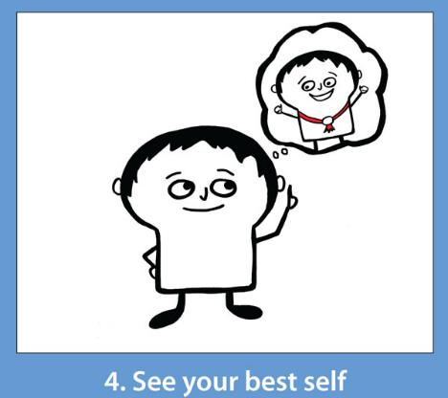
STEP 4: SEE YOUR BEST SELF
Imagine your best self.
What qualities do you possess when you are at your best?
Who you want to be
How you want others to see you (your reputation)
The ideal outcome
Remember: Your best self is different in different roles!
Notes:
TIME: 3 minutes
PURPOSE: To explain Step 4
SAY Now that you can think more clearly and are calmer, the fourth step in the meta-moment process is to “See your best self.” Here is where we consider how our “ideal” self would act in the situation. The self that we are most proud of. Thinking of this helps us to choose the most effective strategy. For example, when you care about preserving a relationship, as most people do with their family members or family friends, then that goal should inform your strategy.
DO: Read the 3 parts of best self*
VISUALIZATION: Close your eyes (if that’s okay) and take a moment to think back to a time when you were triggered by something to be in the RED but acted in a way that you were very proud of.
ASK: What did you do in that moment that was so effective? What did your ideal self look like at that moment?
Facilitator give example from personal story you’ve been sharing: (Did you operate from the “best self?” If not, how might a concept of “best self” helped you have a better outcome?) 1 minute or less

Slide 17
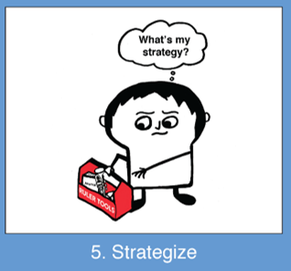
STEP 5: Strategize
Breathing
Mindfulness/Relaxation
Reframing *
Positive Self Talk*
Visualization
Distraction
Physical space/distance
Notes:
TIME: 3 minutes
PURPOSE: To explain Step 4
SAY Now that you can think more clearly and are calmer, the fourth step in the meta-moment process is to “See your best self.” Here is where we consider how our “ideal” self would act in the situation. The self that we are most proud of. Thinking of this helps us to choose the most effective strategy. For example, when you care about preserving a relationship, as most people do with their family members or family friends, then that goal should inform your strategy.
DO: Read the 3 parts of best self*
VISUALIZATION: Close your eyes (if that’s okay) and take a moment to think back to a time when you were triggered by something to be in the RED but acted in a way that you were very proud of.
ASK: What did you do in that moment that was so effective? What did your ideal self look like at that moment?
Facilitator give example from personal story you’ve been sharing: (Did you operate from the “best self?” If not, how might a concept of “best self” helped you have a better outcome?) 1 minute or less

Slide 18
Notes:
TIME: 3 minutes
PURPOSE: to briefly introduce the 6 steps of the Meta Moment and share a personal story for context
DO: As the facilitator, share a 2-3 minute personal story about a time when you were in the red and needed to calm down to handle the situation. Choose a family-focused example. Think about an appropriate time you were triggered. Be prepared to share the thoughts going through your head, how your body was feeling, how you calmed down, what your best self looked like, what strategies you used (or could have used) and how you were successful
SAY:
Definition: The Meta-Moment is the time between when you feel something and when you do something. This process helps us use that space to make a choice that will be effective, that will more likely have the outcome that we desire. Taking a Meta-Moment is invaluable when you need to control your impulses, want to shift your mood and strategize a solution that is more thoughtful (aligned with your values and beliefs)
There are SIX Steps to taking a Meta-Moment, although in real time it happens very quickly.
3. DO: Read the steps briefly and let participants know that you will be taking them through the entire process.
*NOTE:
1. Parents might argue that they don’t have time for Meta-Moments. What most people don’t realize is how much time they spend each day dealing with their own and others’ emotions and picking up the pieces after an ineffective response.

Slide 19
Video – Reframing & Positive Self Talk
https://www.youtube.com/watch?v=1Y-03SlTmRI&index=8&list=PLQFNh9ec4l-sx8fyXyC9iZdLSDdsEUny6

Slide 20
Class Discussion
What strategy’s did the pizza guy use to react to his situation?
How did the pizza guy reframe his situation?
How did positive self-talk help change his reaction to the situation?

Slide 21
Optional Video & Activities

Slide 22
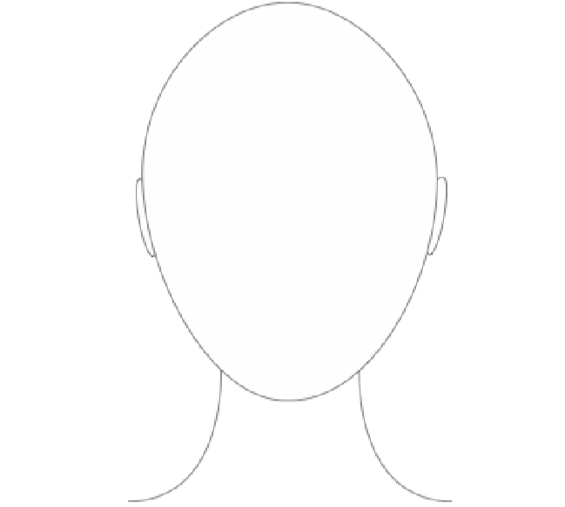
My Best Self
In the profile below, write down the top five qualities that describes your best self?

Slide 23
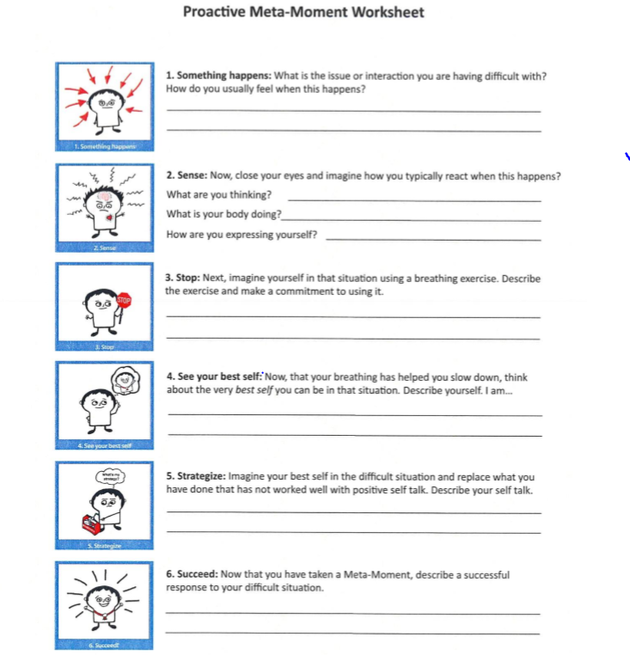
Proactive Meta-Moment Worksheet
http://selmatters.weebly.com/uploads/1/2/0/5/120562389/ruler.mood_meter.meta_moment_worksheet.pdf

Slide 24
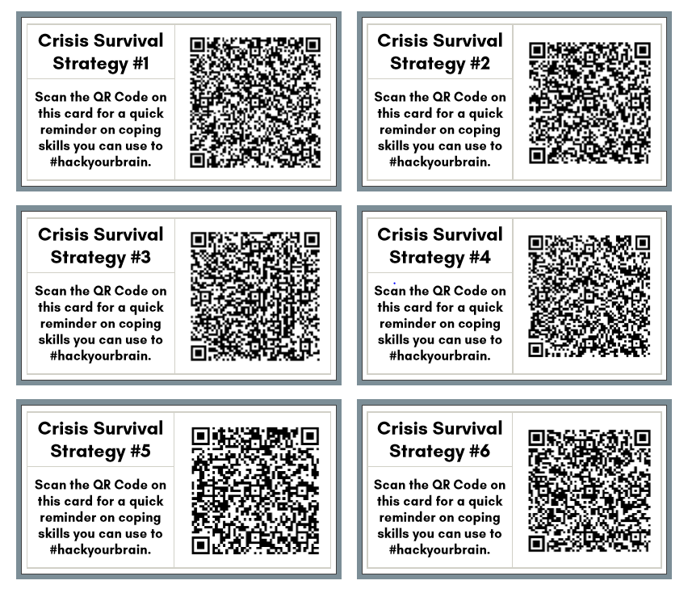
Survival Strategies

Slide 25
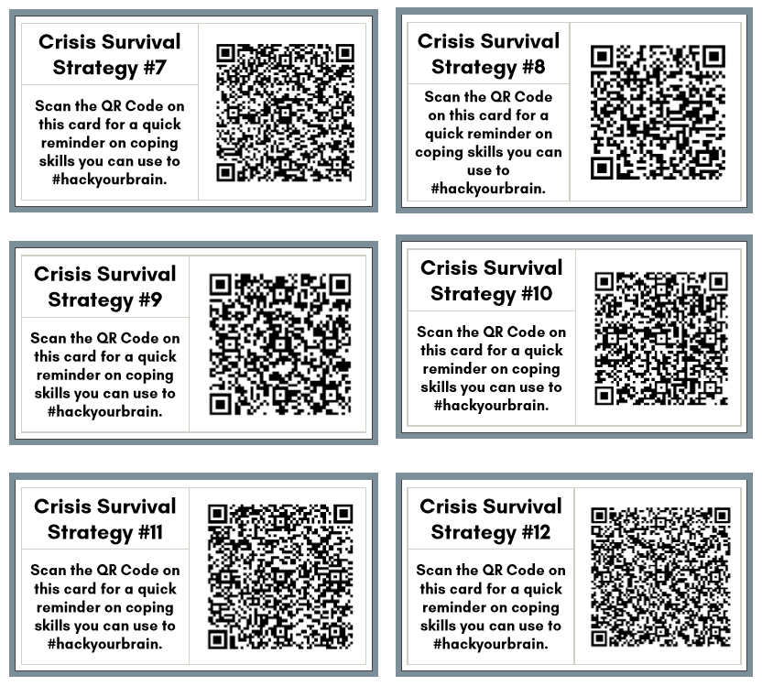
Survival Strategies

