Slide 1
PRIDE: February 19th

Slide 2
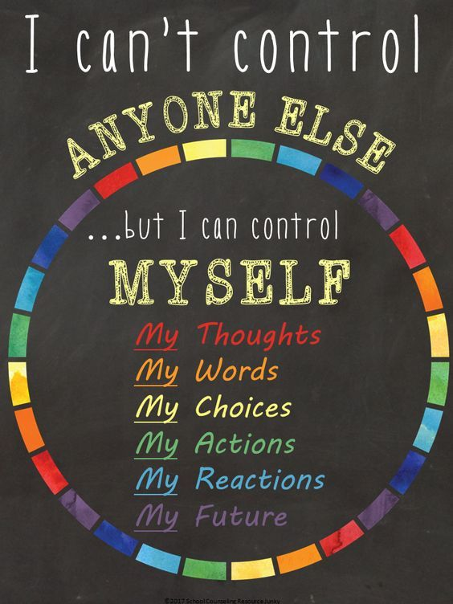
Overview
Recognizing what is in our control helps people cultivate a strong internal locus of control and sense of self-efficacy, which are important building blocks for self-esteem, compassion towards self and others, having a growth mindset, and creating plans to work towards goals, hopes, and dreams.

Slide 3
https://www.youtube.com/watch?v=_f2NkYWDVTs

Slide 4
Activity
https://www.youtube.com/watch?v=nxacynVqWd8

Slide 5
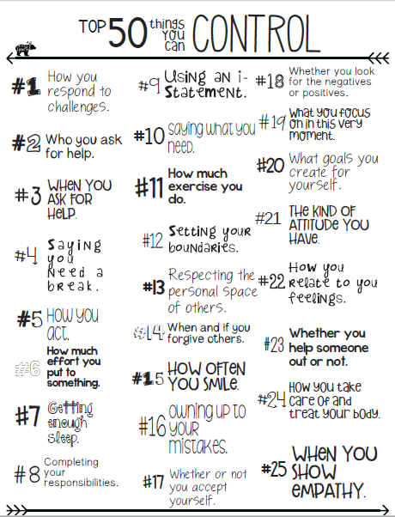
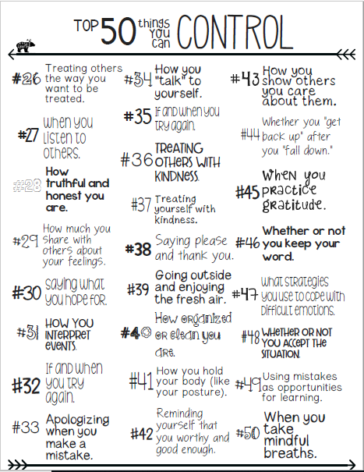
http://selmatters.weebly.com/uploads/1/2/0/5/120562389/top_things_i_can_control.pdf

Slide 6
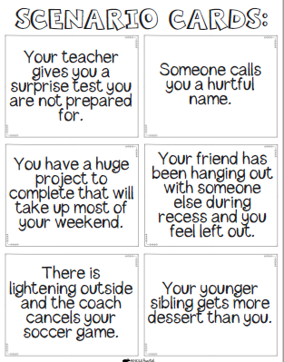
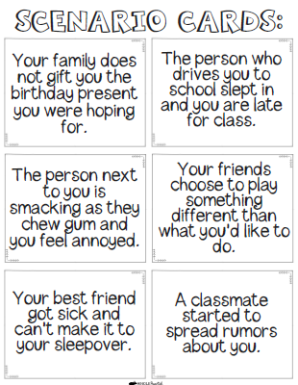
Optional Activities
http://selmatters.weebly.com/uploads/1/2/0/5/120562389/scenario_cards.pdf

