Slide 1
Social Emotional Learning

Slide 2
Overview
Over the past two decades, studies have consistently found that people who practice gratitude report fewer symptoms of illness, including depression, more optimism and happiness, stronger relationships, more generous behavior, and many other benefits.
Further, research convincingly shows that, when compared with their less grateful peers, grateful youth are happier and more satisfied with their lives, friends, family, neighborhood, and selves. They also report more hope, engagement with their hobbies, higher GPAs, and less envy, depression, and materialism.
https://ggsc.berkeley.edu/images/uploads/GGSC_Gratitude_Curriculum_MS_HS.pdf

Slide 3
Objective
Define gratitude and why it’s important
Understand gratitude as an intentional act

Slide 4
Teacher Notes
This Panther Pride we are following a lesson plan based off “An Experience in Gratitude, The Science of Happiness” video by Soul Pancake
Teacher will discuss “gratitude” with students and why it is good for you.
Students will be instructed to write about a person who is really influential in their life and why.
Students will view An Experience in Gratitude, The Science of Happiness” video by Soul Pancake video
Time permitting – students can rewrite in a letter form to share with person

Slide 5
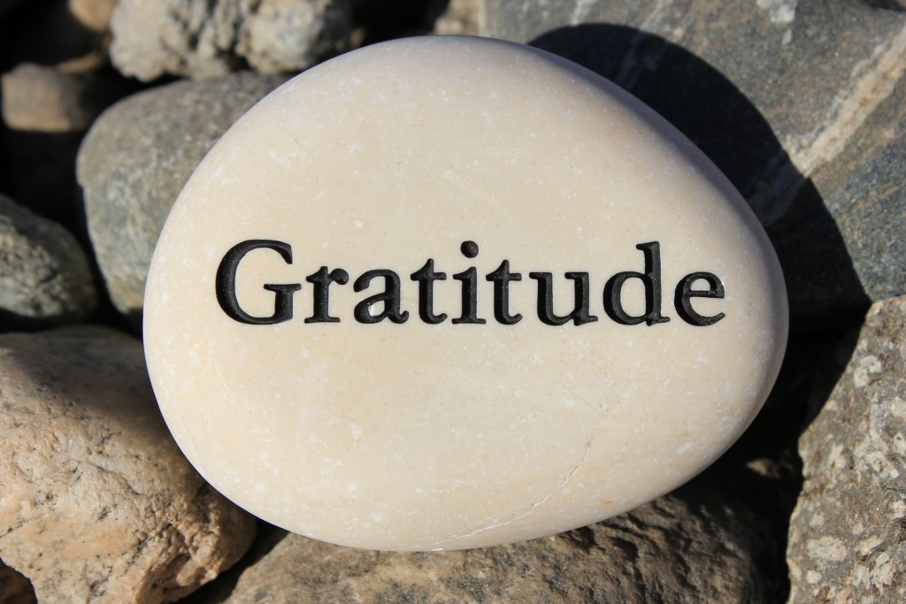
Class Discussion
What is the gratitude?

Slide 6
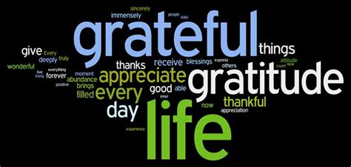
Gratitude
Gratitude = The ability to recognize and acknowledge the good things, people, and places in our lives.

Slide 7
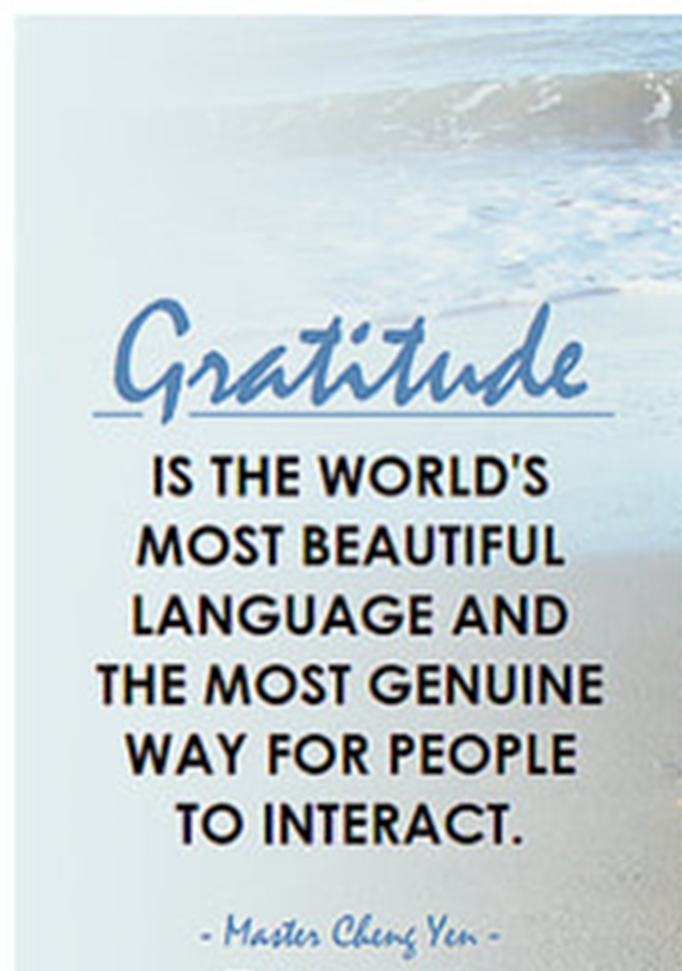
Why Gratitude Is Good
It feels good!
Better physical health
It makes relationships stronger
It makes people feel happier in the long-run

Slide 8
Class Activity
Close your eyes and think of someone who is really influential in your life/and or matters to you most.
Open your eyes. On a sheet a paper write down who this person is and as much as you can about why this person is so important to you.

Slide 9
Video: Gratitude Project
https://www.youtube.com/watch?v=oHv6vTKD6lg

Slide 10
Expressing Gratitude
Expressing gratitude, or saying “thank you,” is critical for relationships. It helps each person recognize the other person’s efforts and makes the other person feel appreciated.
When we express gratitude, we communicate to the
important people in our lives how they matter to us AND, over time, we get closer to these people because they help us reach significant goals in our lives. It’s glue for who and what matters

Slide 11
Gratitude Project cont.
Re-write your paper as a letter or a thank you card to your most influential person.
Give this letter or card to the person or call them and share it with them.

Slide 12
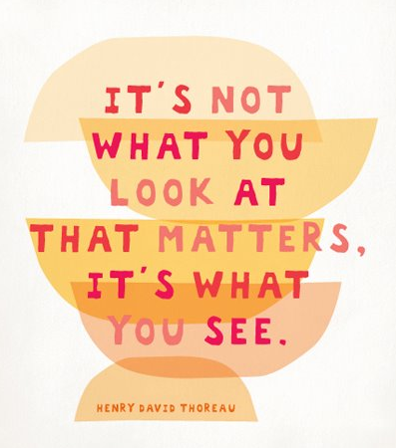
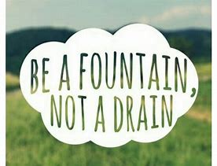
Gratitude Is A Choice
You choose how you think.
It’s your choice to focus on good things or bad things in life.
You also choose how you act.
It’s also your choice whether you want to do things that lift others up or bring them down

Slide 13
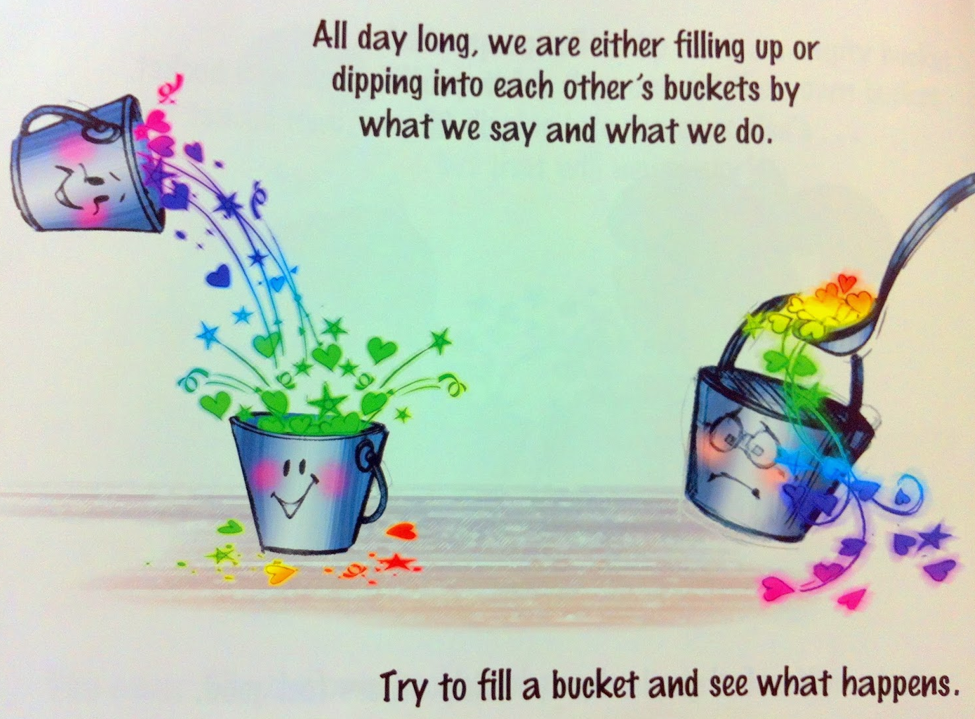
Bucket Filling
Practice expressing kindness towards your classmates and fill their bucket
You can:
• Tell them thank you for doing
something kind for you
• Compliment them on one of
their strengths or talents

Slide 14
Optional Video & Activities

