Slide 1
Social Emotional Lesson
*1/7 - 1/11

Slide 2
Overview
New Year – Better You
#betterselfie
End of year marks a threshold and invites us all to reflect on our accomplishments of 2018 and prompts us to think about changes we could make to better ourselves and the world around us in 2019.

Slide 3
Monday 2018 Reflection

Slide 4
Collaborate
What was your biggest accomplishment in 2018?
What are you most looking forward to in 2019?

Slide 5
https://www.youtube.com/watch?v=dJVp8b1SQhA

Slide 6
Class Discussion
What is one thing you can do to make a better you this year?
https://selmatters.weebly.com/uploads/1/2/0/5/120562389/yearendandnewyearreflectionworksheet__1_.pdf

Slide 7
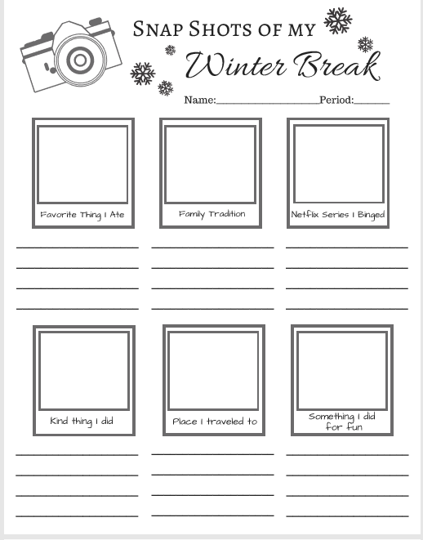
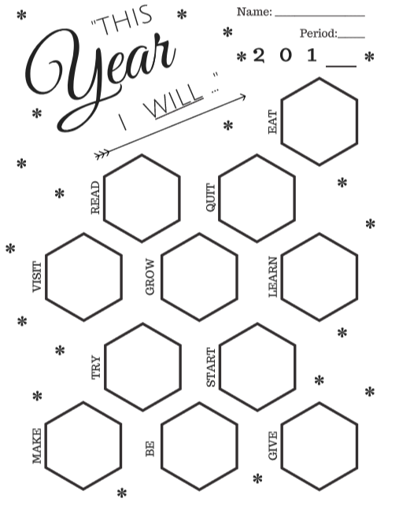
Additional Activity
https://selmatters.weebly.com/uploads/1/2/0/5/120562389/yearendandnewyearreflectionworksheet__1_.pdf

Slide 8
Tuesday

Slide 9
Class Discussion
What would the perfect day look like to you?

Slide 11
Three Questions
How can I grow ?
What can I give?
What can I celebrate?

Slide 12
Wednesday

Slide 13
https://www.youtube.com/watch?v=lQAG4JcI0x8

Slide 14
Thursday

Slide 15
https://www.youtube.com/watch?v=m5yCOSHeYn4

Slide 16
Collaborate
What is one thing we should say more often?
Pick one you will commit to say more often this year

Slide 17
Friday Unity Day

