Slide 1
Day 1 Growing your Brain
Academic Success and Growth Mindset

Slide 2
Day 1 – Video & Debrief
Video – “Brain Jump with Ned Neuron: Challenges grow your Brain” (1:51). After you have watched the video with your class hold a small discussion about the science behind the brain and how challenges make it grow.
Class discussion: Here are a few questions to get your discussion started
What’s one thing you’ve done recently that made your brain stronger?
How could you tell your brain was getting stronger?
Extension Activity:
Kahoot – Growing our Brain - questions include information from today’s video

Slide 3
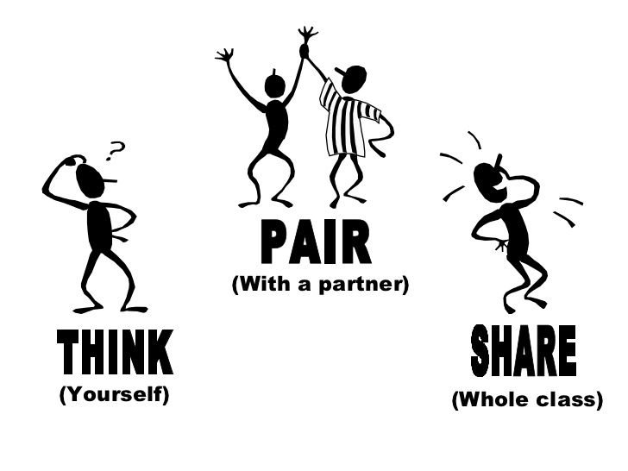
Pre-Video discussion
1. What’s one thing you’ve worked hard to get better at?
2. What did you do to get better?

Slide 4
VIDEO
https://www.youtube.com/watch?v=g7FdMi03CzI

Slide 5
Class Discussion
1. What’s one thing you’ve done recently that made your brain stronger?
2. How could you tell your brain was getting stronger?

Slide 6
Kahoot – Growing Your Brain
https://create.kahoot.it/details/growing-our-brain/42c00518-8ea1-408a-bce4-2d3d27224d17

Slide 7
Day 2 Brain Neuroplasticity

Slide 8
Day 2 – Video & Debrief
Video – “Neuroplasticity” (2:04). After you have watched the video with your class hold a small discussion how the brain can be rewired as we think differently.
Class discussion: Here are a few questions to get your discussion started
What is neuroplasticity?
How does neuroplasticity work?
How can you “rewire” your brain?
Activity:
Student will identify three things they could do this week to make new connections

Slide 9
Pre-Video Discussion
What do you think happens to your brain when you learn new things?

Slide 10
https://www.youtube.com/watch?v=ELpfYCZa87g

Slide 11
Class Discussion
What is neuroplasticity?
How does neuroplasticity work?
How can you “rewire” your brain?

Slide 12
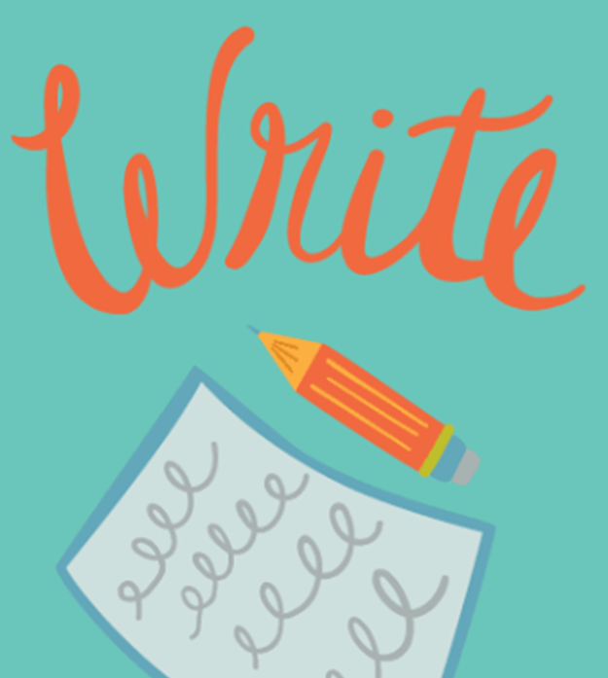
Identify three things you could do this week to make new connections

Slide 13
Day 3 Making Mistakes

Slide 14
Day 3 – Making Mistakes and Brain Connections
Class discussion –
Students will discussion how it feels to make mistakes and why?
Personal Discussion: As a teachers you may use this time to share a personal story about a time you had to work hard to get better at something.
Activity: Each student will need a small piece of paper. (3x5 or ¼ of a piece of paper)
Students will write on the piece of paper one mistake they have made in the past
Students will crumple up the paper and then un-crumple the paper
They will color in all the creases, using different colors in they have them
Class Discussion:
The lines on your paper represent all the new connections your brain made because of your mistake.
Keep this paper as a reminder of how making mistakes strengthens your brain.

Slide 15
How do you feel when you make a mistake?
Why?

Slide 16
On a piece of paper, write about a mistake you made recently.
No one else will see what you write.

Slide 17
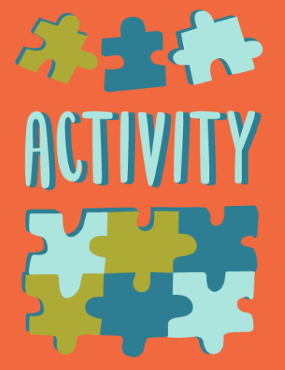
Crumple up your paper and then un-crumple it
Color in all the creases, using different colors if you have them

Slide 18
Discussion
The lines on your paper represent all the new connections your brain made because of your mistake.
Keep this paper as a reminder of how making mistakes strengthens your brain.

Slide 19
Day 4 Grit

Slide 20
Day 4 – Grit
Game: “Who is this?”
Students play a game in which they guess the identities of famous people.
Video: TEDTalk “Grit: The Power of Passion and Perseverance” (6:12)
Class Discussion:

Slide 22
Who is J.K. Rowling?
J.K. Rowling is the author of the best-selling Harry Potter series.

Slide 23
Who is Michael Jordan?
Michael Jordan is one of the most decorated players in the history of the NBA.

Slide 24
Who is Malala Yousafzai?
Malala Yousafzai is a Pakistani human rights activist and the youngest person to be awarded the Nobel Peace Prize.

Slide 25
Who is Stephen Hawking?
An average student at school, Stephen Hawking went on to be a world-famous cosmologist. He lived to be 76 years old.

Slide 26
Who is Bruce Lee?
Bruce Lee was involved in a street gang as a boy, so his parents sent him to study martial arts to keep him out of trouble. He starred in more than 30 movies and was a director, philosopher, and poet.

Slide 27
Who is Walt Disney?
Walt Disney produced the first full-length animated movie and is the creator of Disneyland.

Slide 28
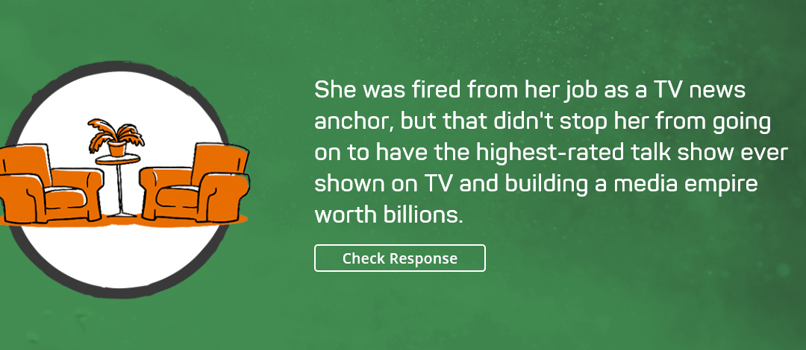
Who is Oprah Winfrey?
More than 10 million people watched The Oprah Winfrey Show when it was on air from 1986–2011. In 2005, a public poll named Oprah the greatest woman in American history.

Slide 29
https://www.youtube.com/watch?v=H14bBuluwB8

Slide 30
Day 5 Letters to a Future Students

Slide 31
Day 5 – Letters to a Future Student
Video – “A Pep Talk from Kid President to You” (3:27).
Activity: students will write a “pep talk” letter
Students will write a “pep talk” letter to a friend or future student.
Teachers can collect letters to hand out during exam time or encourage students to give letters to friends.

Slide 32
https://www.youtube.com/watch?v=l-gQLqv9f4o

Slide 33
“Pep talk” letter to a Friend or Future student
Take a few minutes to think of a time when you overcame a struggle to learn something. It could be anything - from adding negative numbers to learning a technique in baseball to writing an introduction for a difficult essay.
Reflect on the times when you failed at first but through persevering your brain created new neural connections and you eventually became better at the task at hand.

Slide 34
Write your Letter
Write a letter to a future student of your class about this struggle. In at least five sentences, tell this student your story and give them advice on what they should do next time they encounter an obstacle when learning something new.
An example is provided. Feel free to be as creative as you would like.

Slide 35
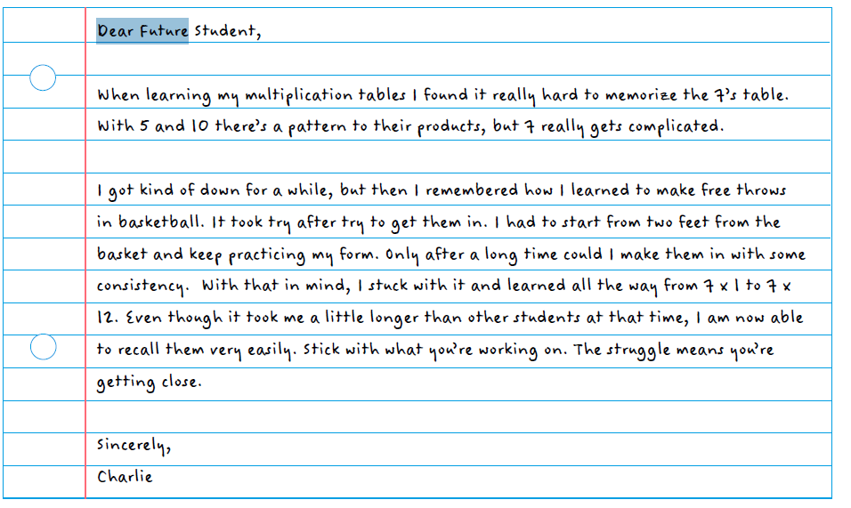

Slide 36
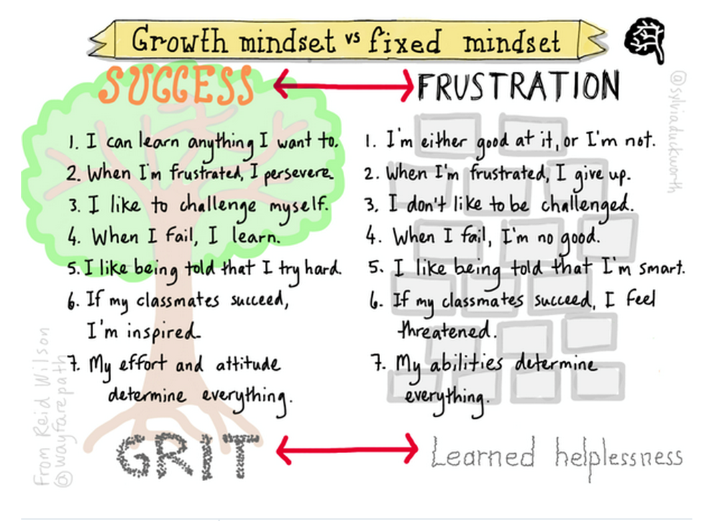

Slide 37
Extension Videos
The Adaptable Mind

