Slide 1
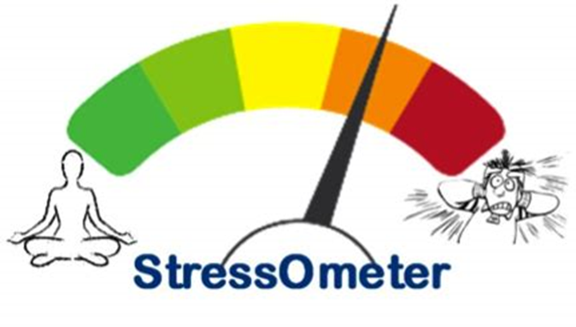
Happiness, Stress & Your Body
Mapping your Day – Identifying your Stress Triggers

Slide 2
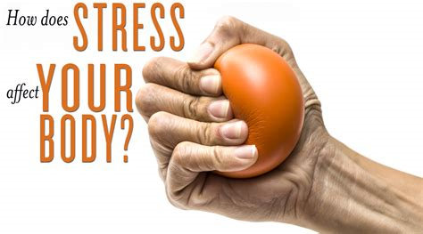
Lesson objective
Discuss and challenge ideas of what happiness it
Define stress and explore solutions to overcome it
Identify personal stress triggers
Evaluate the effects happiness and stress can have on your health

Slide 3
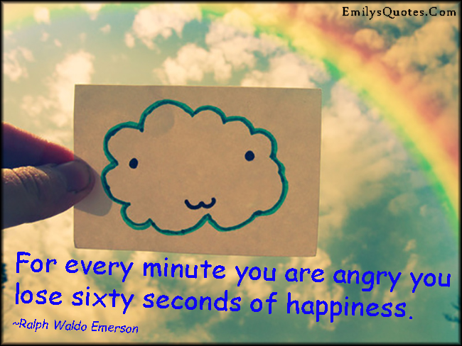

Slide 4
What is happiness?
1. Work with a partner to write down a definition of happiness
2. Share with the class

Slide 5
3. Why would happiness effect your health?

Slide 6
http://www.youtube.com/embed/IIWQeMFncm8

Slide 7
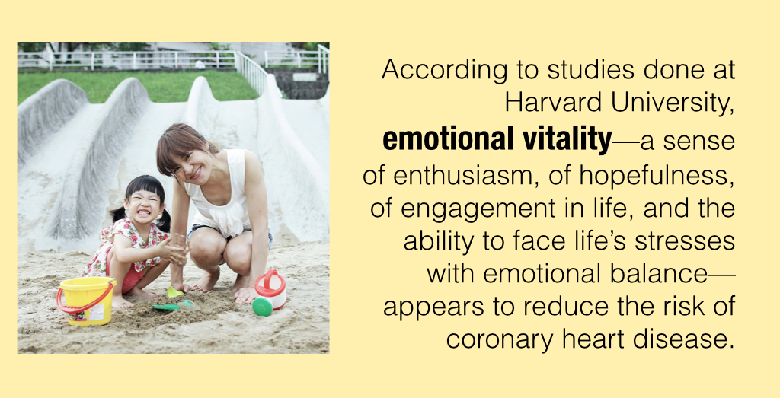

Slide 10
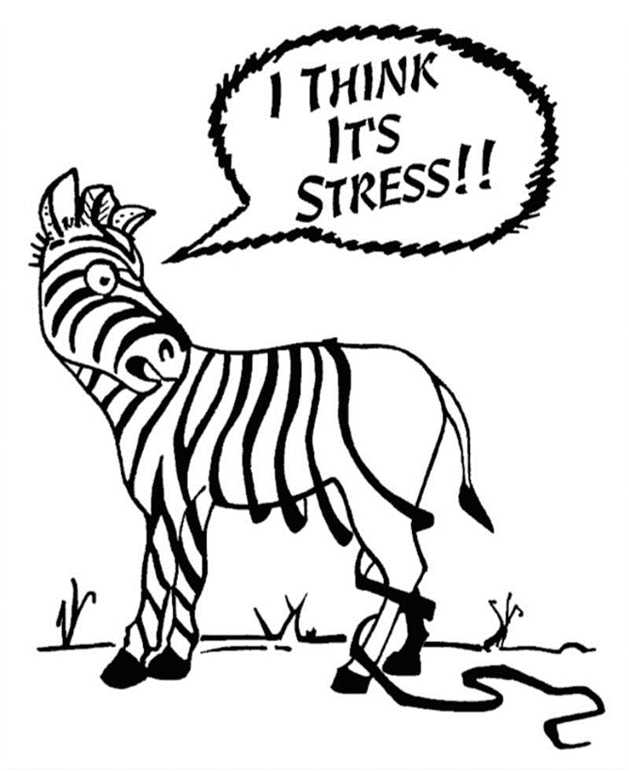
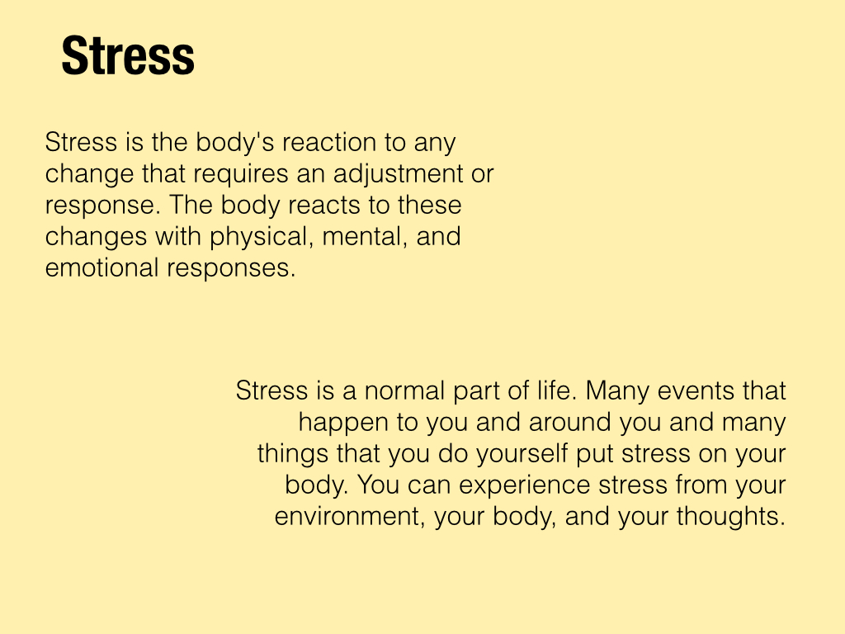

Slide 11
http://www.youtube.com/embed/0fL-pn80s-c

Slide 12
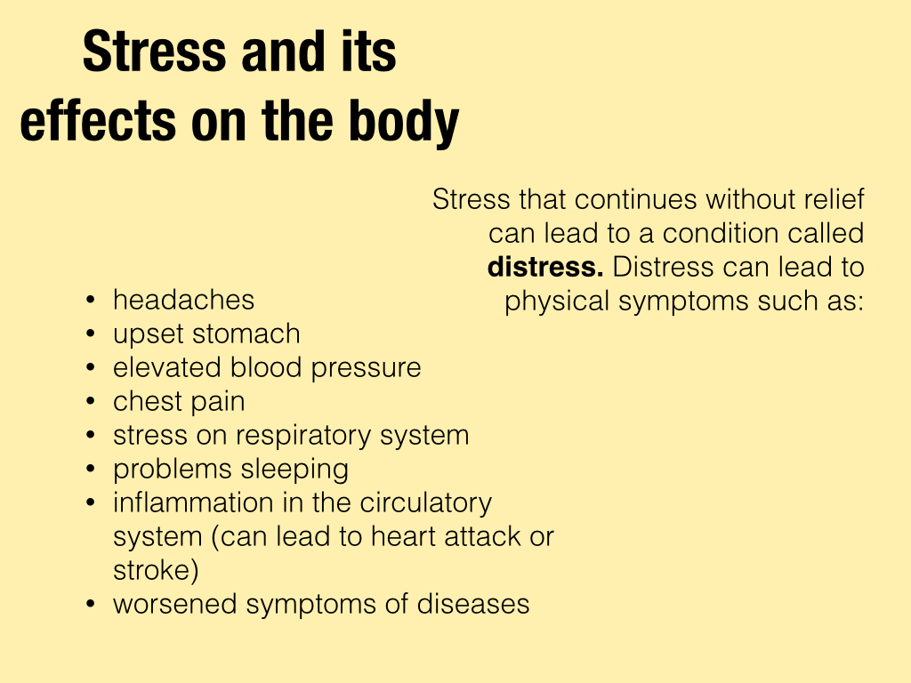

Slide 13
Stress Triggers – Map your day activity
Collect a Daily Stress Graph from your teacher
For each daily activity, plot the stress meter number that correlates to the activity.
Use the map to identify triggers in your day that are causing stress.
Explore stress relief tips you can use to decrease stress in your life.

Slide 14
Stress Triggers – Map your Day
3
5= I Need some HELP!!!!​ - Angry/Panic
4= I'm REALLY stressed.... ​Overwhelmed
3= Little Stress....​ Frustrated
2= Trying to stay Focused ....​ Anxious
1= Feeling GREAT....​ Happy
​
2
4
1
5
Directions: For each daily activity, plot the stress meter number that correlates to the activity. Use the map to identify triggers in your day that are causing stress. Explore stress relief tips you can use to decrease stress in your life.
5
4
3
2
1
 | before school | transition to school | breakfast | 1st | 2nd | 3rd | 4th | 5th | LUNCH | 6th | 7th | afterschool activty | transition home

Slide 15
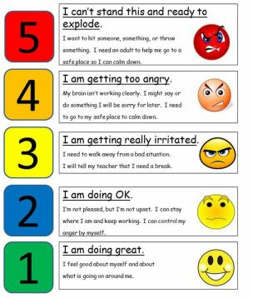

Slide 16
Activities
Stress Checklist
Stress: What Brings it On?
Map your Day – Identifying Stress Triggers
Click on link below to find all stress activities
https://selmatters.weebly.com/stress-lessons.html

Slide 17
KAHOOT
What is stress & how does it affect our body?
https://play.kahoot.it/#/k/82581392-cfa0-4dfc-aff8-16d12fff44d8

