Slide 1
Social Emotional Learning
*Lessons for 1/14 – 1/18

Slide 2
Overview
Unity Day we identified stress triggers in our life. Identifying and managing our own emotions is essential to our personal well-being and decreasing stress in our life. Accurately identifying others’ emotions is essential to our social well-being and happiness. The ability to pick up on others’ emotions helps us manage, communicate, and collaborate with them more effectively. Put simply, it enables us to get along better with people in general. The inability or non-conscious choice not to identify how people are feeling can easily lead to conflict and problems. This week we will focus identifying our emotions.

Slide 3
Monday

Slide 4
Intro to Emotions
CLICK ON LINK BELOW
https://youtu.be/FnpYANGcRhs

Slide 5
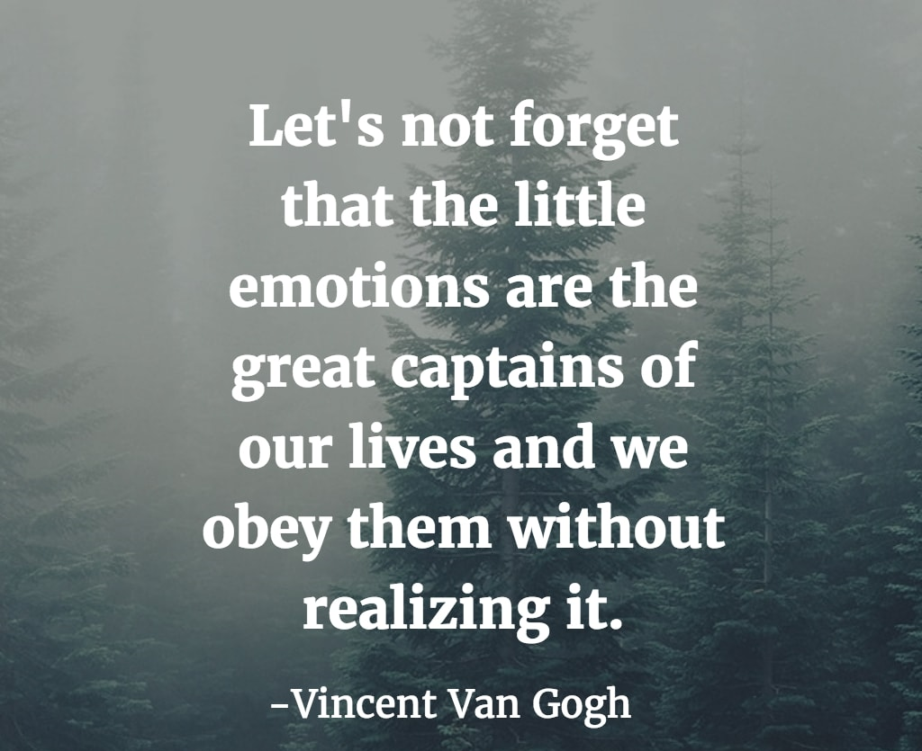
Emotions
In order to effectively regulate our emotions, we must 1st learn to recognize them
Name some others emotions not mentioned in the video?

Slide 6
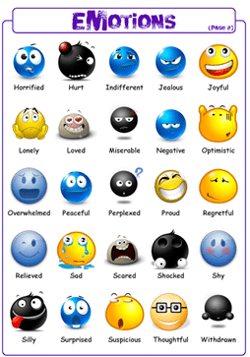

Slide 7
Tuesday

Slide 8
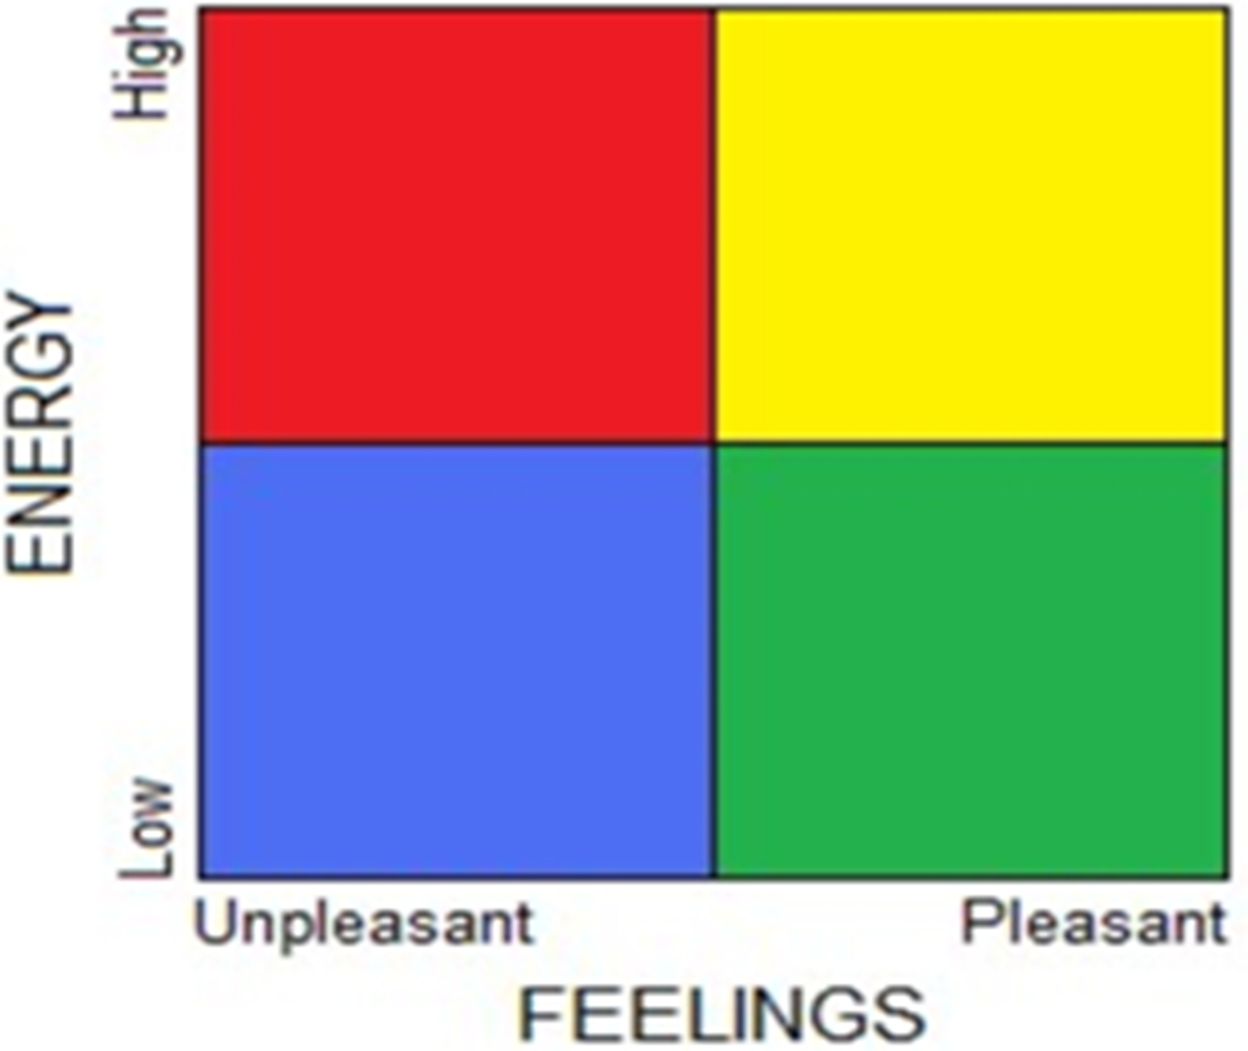
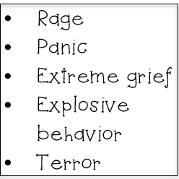
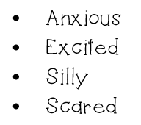
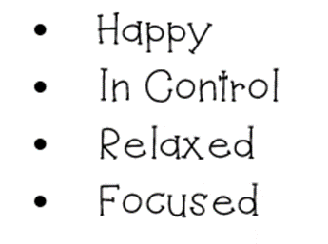
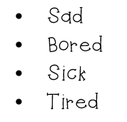
Extremely heightened level of alertness and out of control
Heightened level of alertness but maintains control
MOOD METER
Is a tool used to recognize and understand our own and other peoples' emotions.
When we are able to identify our emotions and what zone we are in, it helps us understand the impact emotions can have on our decisions and behavior.
Low Level of Alertness
Ideal level of alertness,
in control
It is also the first step in developing empathy, which is the ability to understand the feelings of another person.

Slide 9
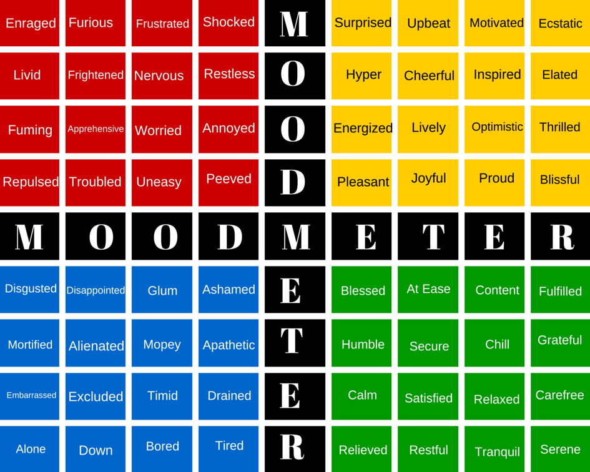
Activity
Red Zone Yellow Zone
Watch each video clip.
What Emotion they are experiencing?
What Zone they are in?
GO TO WEBSITE TO VIEW VIDEOS
Blue Zone Green Zone
https://selmatters.weebly.com/sel-lesson-plans-2.html

Slide 10
Thursday

Slide 11
https://www.youtube.com/watch?v=3bKuoH8CkFc

Slide 12
Activity
Sort each scenario based on what zone you think would be appropriate to be in given the scenario

Slide 13
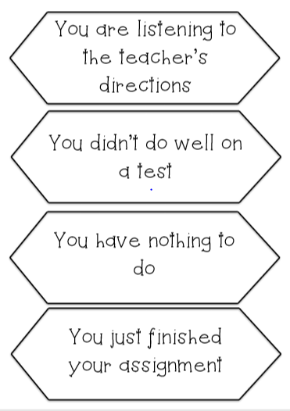
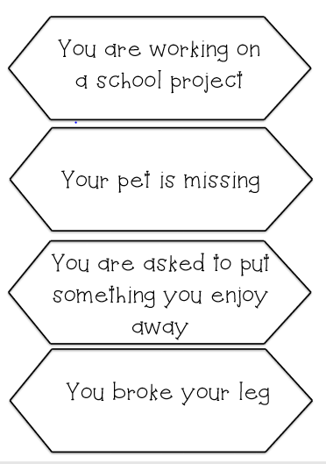

Slide 15
Friday

Slide 16
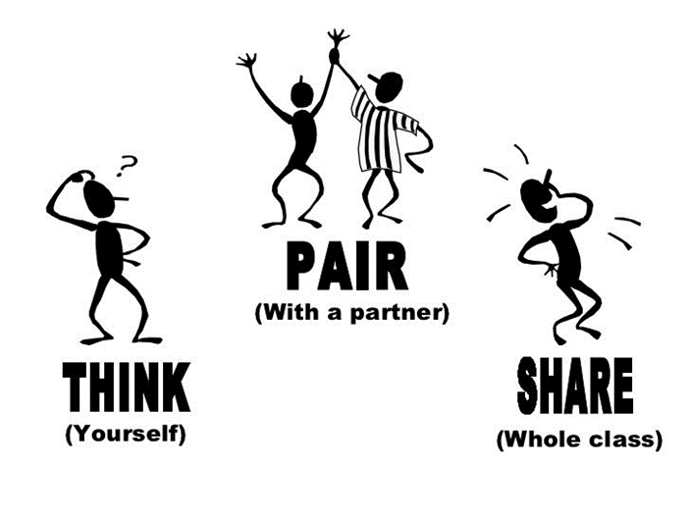
How do we send our emotional messages?
We feel emotions all the time—everyday. As we get older, we have to get better at sending those messages in smaller packages. There are two ways to send a message—in a BIG PACKAGE or in a
A BIG PACKAGE is when we stomp around, throw a fit, and make a big scene. A small package is when we communicate our feelings but in a calmer way, like walking away and taking a break instead of throwing a fit.
Our feelings are contagious. They are like germs and can spread to others. Other people can catch how we are feeling. So we have to be careful how we package our emotions so others don’t feel bad.
Share a time you sent your emotional message in a BIG PACKAGE.
Who did it effect?
How could you have sent it in a small package

Slide 17
Activity – Is their reaction a BIG PACKAGE or small package?
What is the situation that caused an overreaction?
2. What would the expected response be?
3. What zone was the reaction in?
4. How do these feelings affect others

Slide 18
Activity – Is their reaction a BIG PACKAGE or small package?
What is the situation that caused an overreaction?
2. What would the expected response be?
3. What zone was the reaction in?
4. How do these feelings affect others

Slide 19
Optional Video & Activities

Slide 20
Kahoot
ZONES OF REGULATION
https://play.kahoot.it/#/?quizId=1f618022-3eca-483e-a87d-d13c5636796e

