Slide 1
Social Emotional Learning
Communication
*Lessons for 12/3 – 12/7

Slide 2
Overview
Communication is a two way street. Listening skills and appropriate responding are more complex than most people realize, involving give and take. Listening and appropriate responding are both essential for effective communication. Helping students learn and practice listening is a much more effective approach to improving behavior than reprimands and punishment

Slide 3
Objective
Understand the difference between hearing and listening.
Understand appropriate responding during conversations.

Slide 4
Monday

Slide 5
Collaboration
Think of who someone who is a good listener
Share with your partner why this person is a good listener
Share as a class characteristics of a good listener

Slide 6
Video: It’s not about the nail
https://www.youtube.com/watch?v=-4EDhdAHrOg

Slide 7
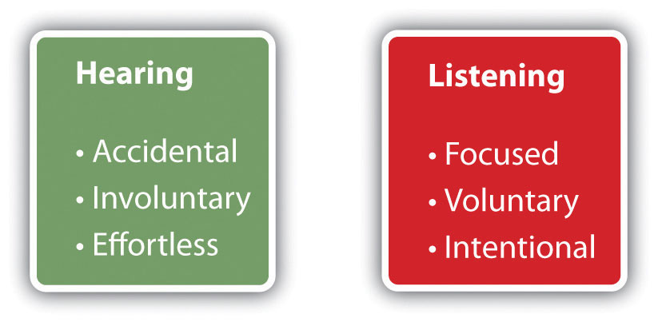
Vocabulary
Listening = to pay attention in order to hear. "Listening means taking a interest in what is being told us.
Listening is a Skill!
Hearing = the act or power of taking in sound through the ear.
vs

Slide 8
Tuesday

Slide 9
Collaboration
How do you feel when someone doesn’t listen to you?

Slide 10
Active Listening Tips
Focus on the person speaking.
Show by your tone of voice, your friendly expression, and your “body language” that you are interested and want to be helpful.
Don’t interrupt.
Accept the person’s feeling without judgment.
Paraphrase what the person has said to be sure you understand.
Express empathy validate these feelings rather than questioning or defending against them

Slide 11
Video: Empathy
https://www.youtube.com/watch?v=QT6FdhKriB8&t=20s

Slide 12
Wednesday Active Listening Tips

Slide 13
Video:
Please click on link below to view video
Chess Clock Communication
https://youtu.be/sr1uS8KZbto

Slide 14
Class Discussion
What were some signs that Sheldon was not actively listening? (use active listening tips from yesterday)
How could Sheldon have become a better listener to Raj?

Slide 15
Thursday

Slide 16
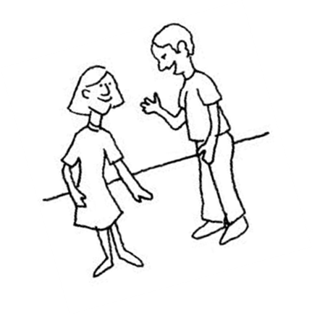
Active Listening Activity
With a partner, one person will speak while the other person listens – no comments or questions. (1 min max)
The listener practices non-verbal listening skills.
The listener has 15 seconds to paraphrase what he/she has just heard. “Speaker” now listens.
Reverse the roles.
What is your favorite class and why?

Slide 17
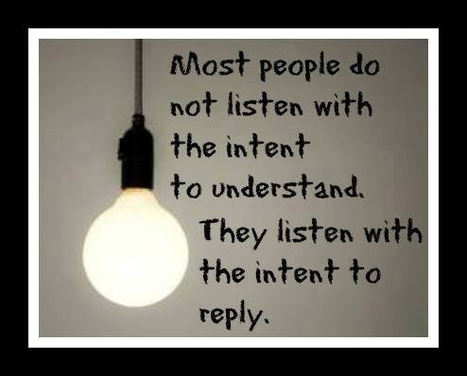
Class Discussion
Was it easy or hard to only listen?
Was it easy or hard to paraphrase?
When you were the speaker, what was it like to hear yourself paraphrased?
Which role do you prefer?

Slide 18
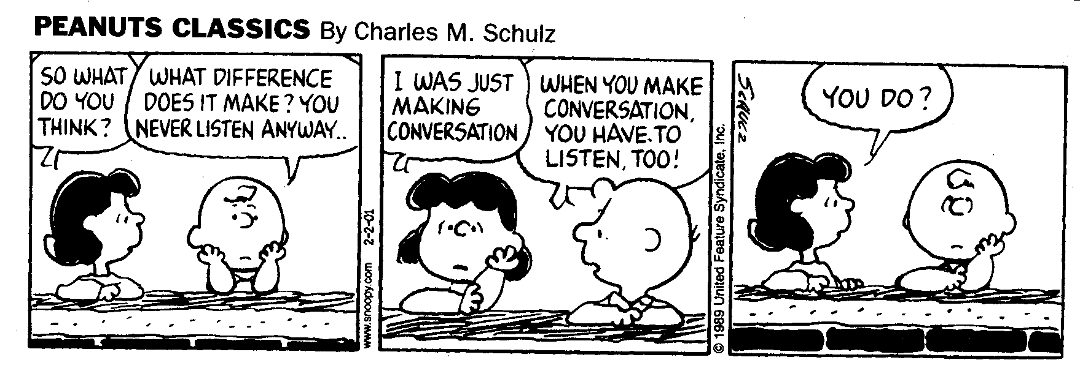
What is listening tool do you need to get better at?

Slide 19
Friday

Slide 20
Collaboration
How can communication create a misunderstanding?

Slide 21
Class Activity - Telephone
Divide class into three or four equal teams. Have teams sit or stand in a straight line. They need to be close enough that whispering is possible, but not so close that players can hear each other whisper.
The last player in line whispers a phrase into the ear of the person sitting or standing in front of them. (Teacher may give the phrase to student)
Players whisper the phrase to their neighbors until it reaches the first player in line.
The first player says the word or phrase out loud so everyone can hear
The team that gets the phrase correct gets a point.

Slide 22
Class Discussion
How can something whispered be so totally changed when it moves through a group of people.
How could not hearing someone correctly cause a misunderstanding or rumor to start?

